Slide 1
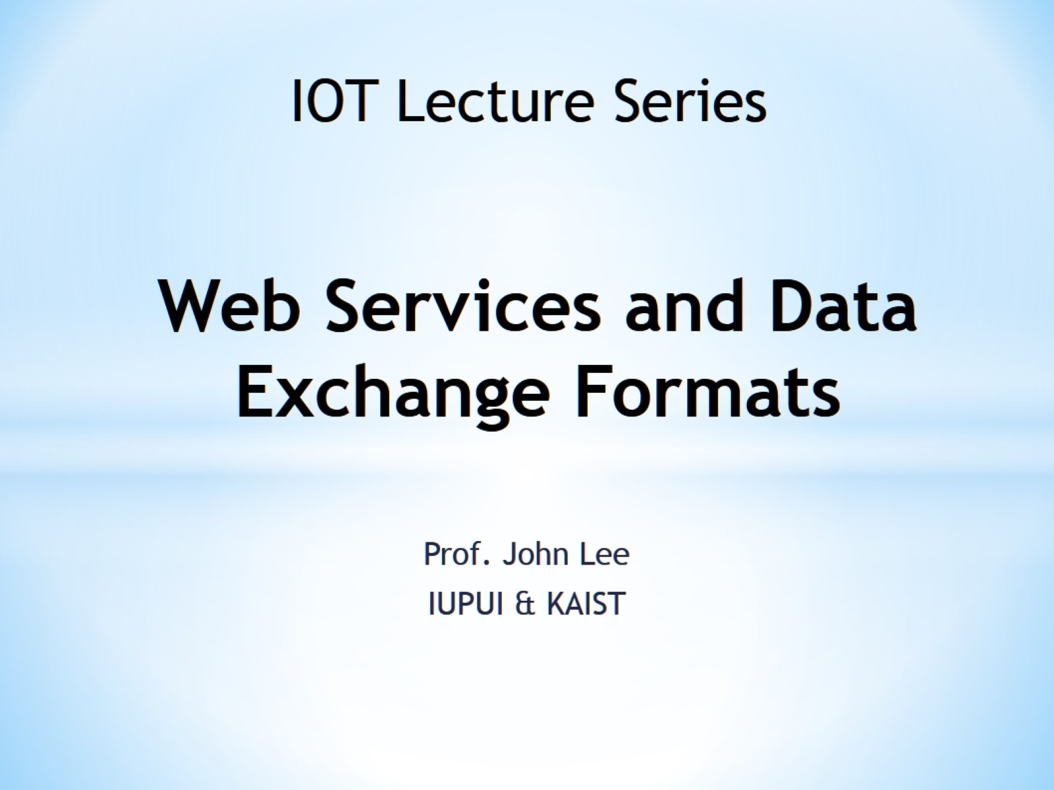
Web Services and Data Exchange Formats

Slide 2
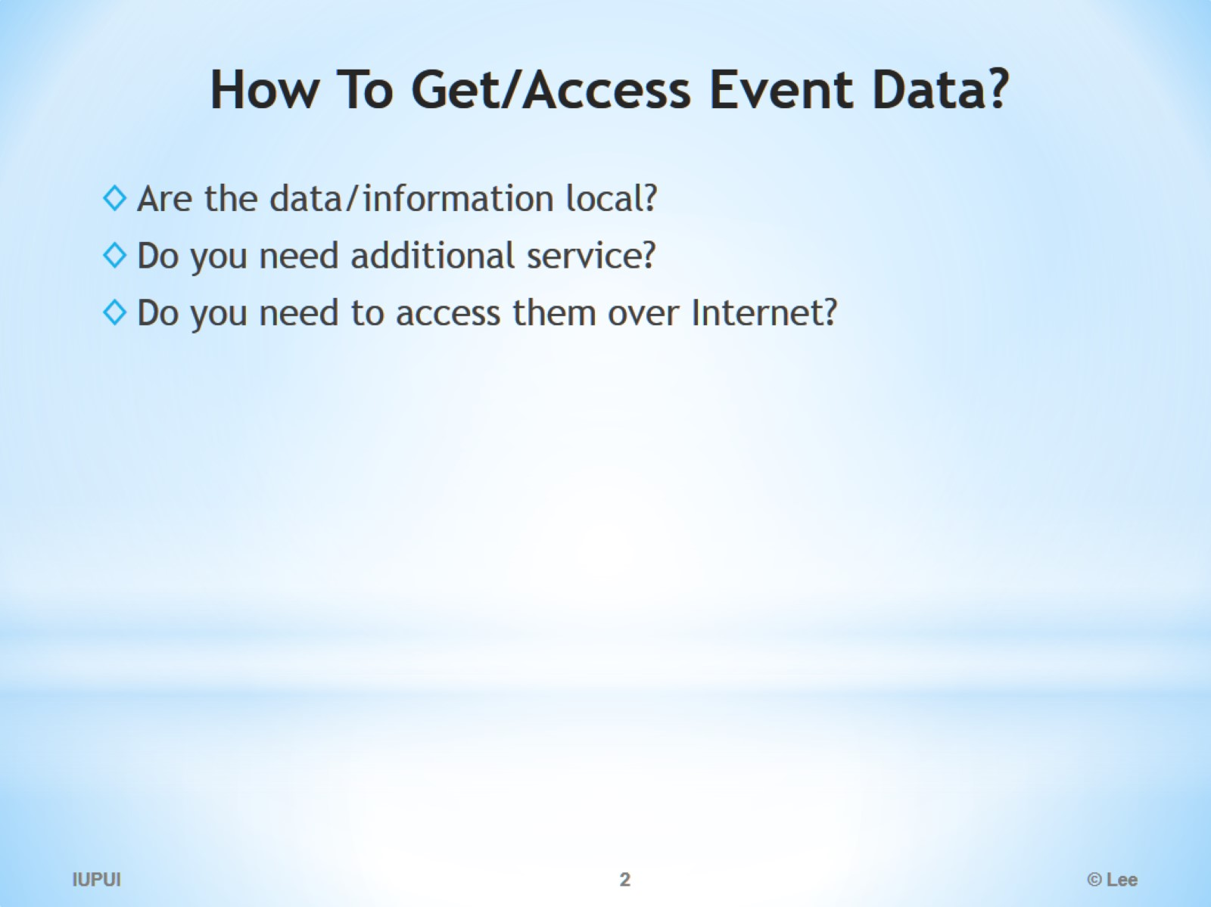
How To Get/Access Event Data?

Slide 3
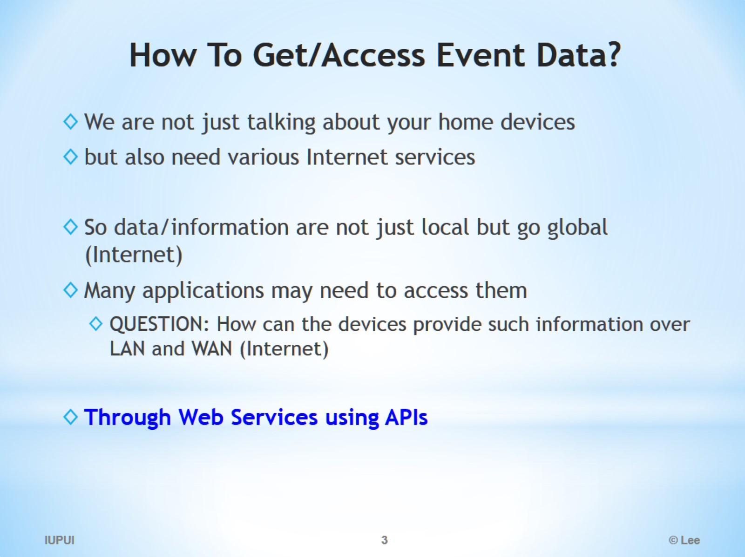
How To Get/Access Event Data?

Slide 4
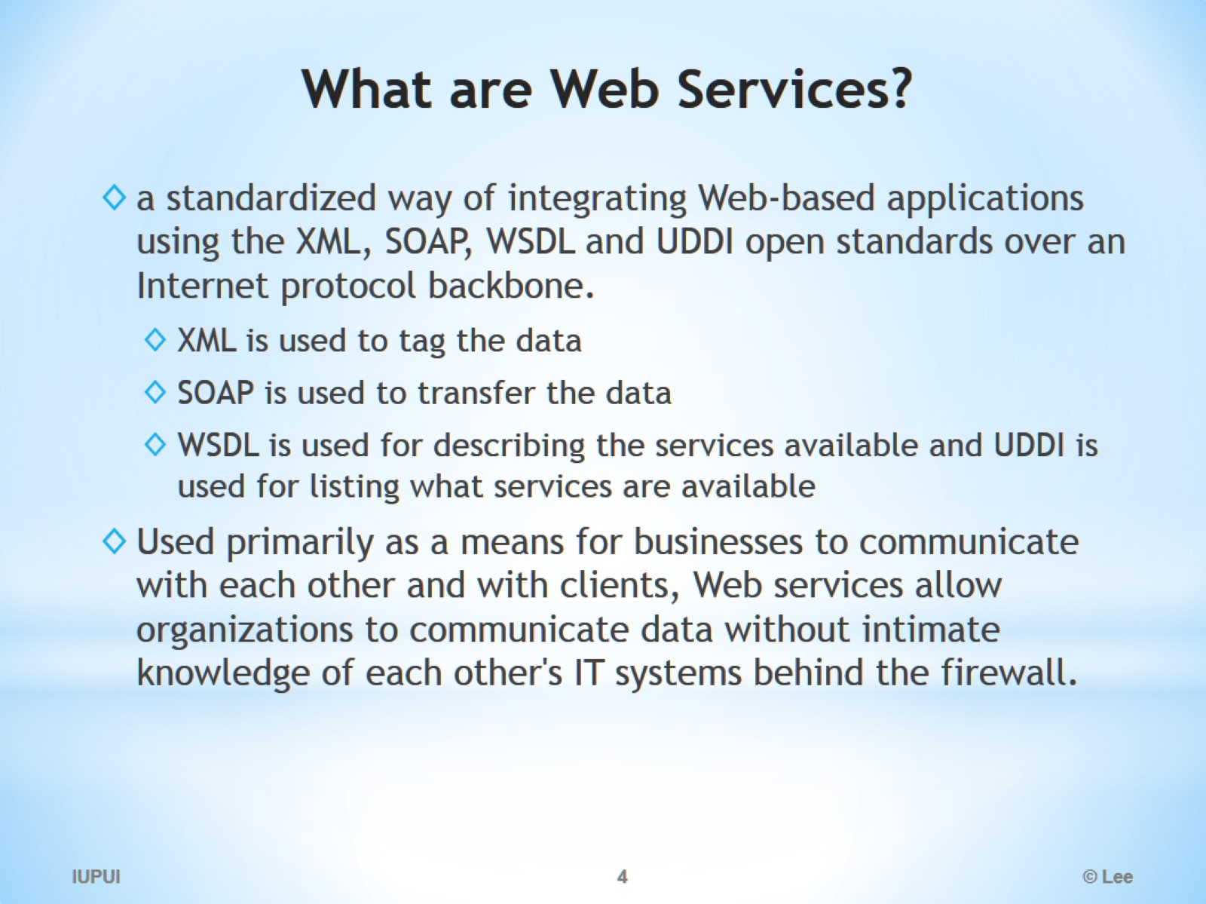
What are Web Services?

Slide 5
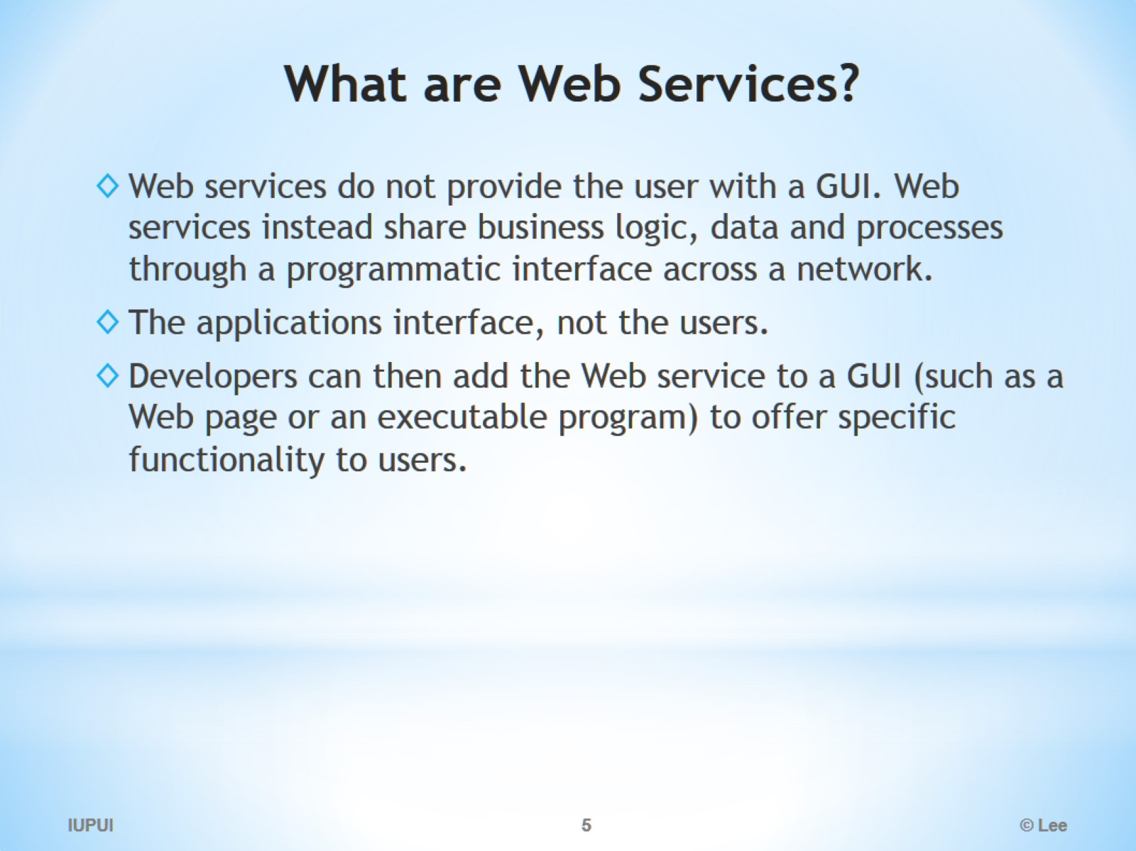
What are Web Services?

Slide 6
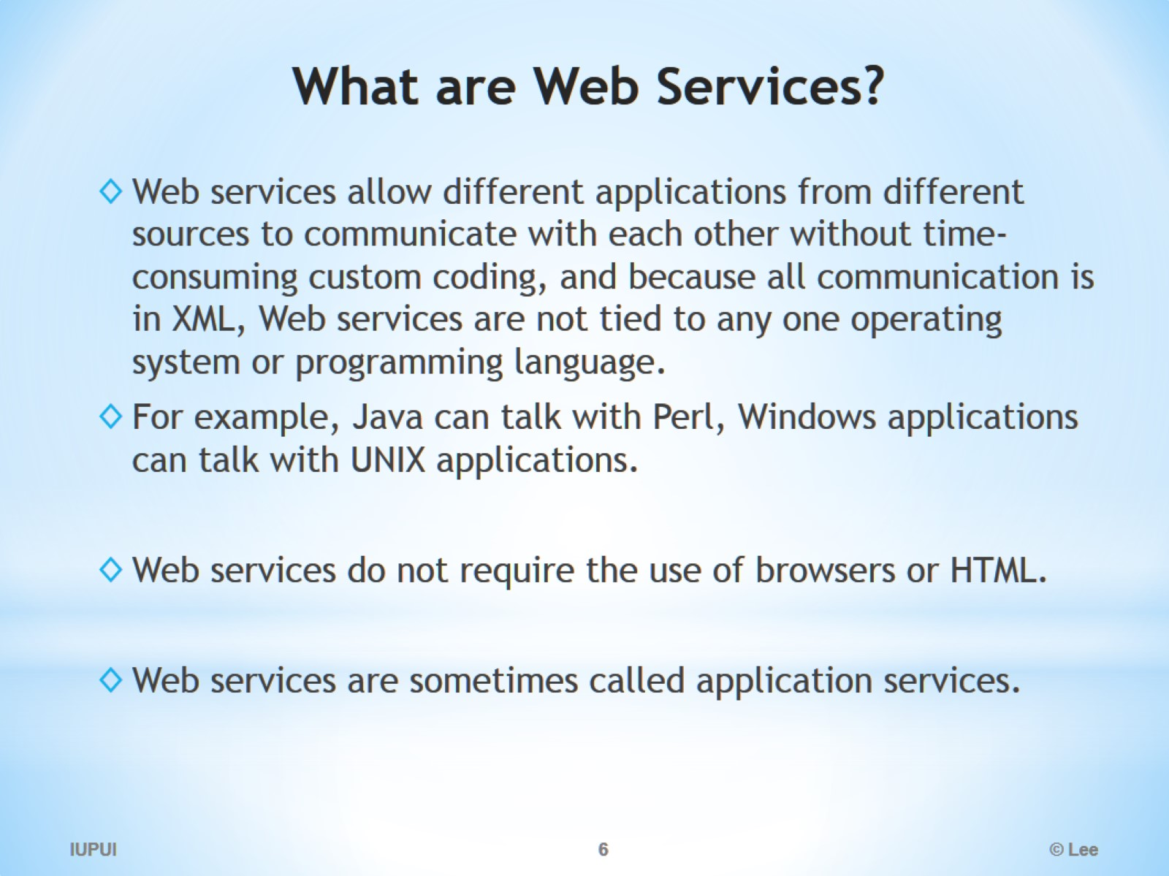
What are Web Services?

Slide 7
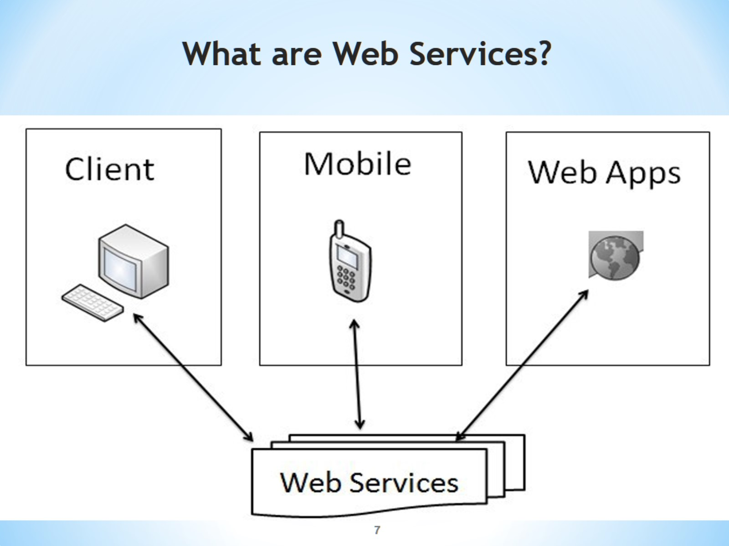
What are Web Services?

Slide 8
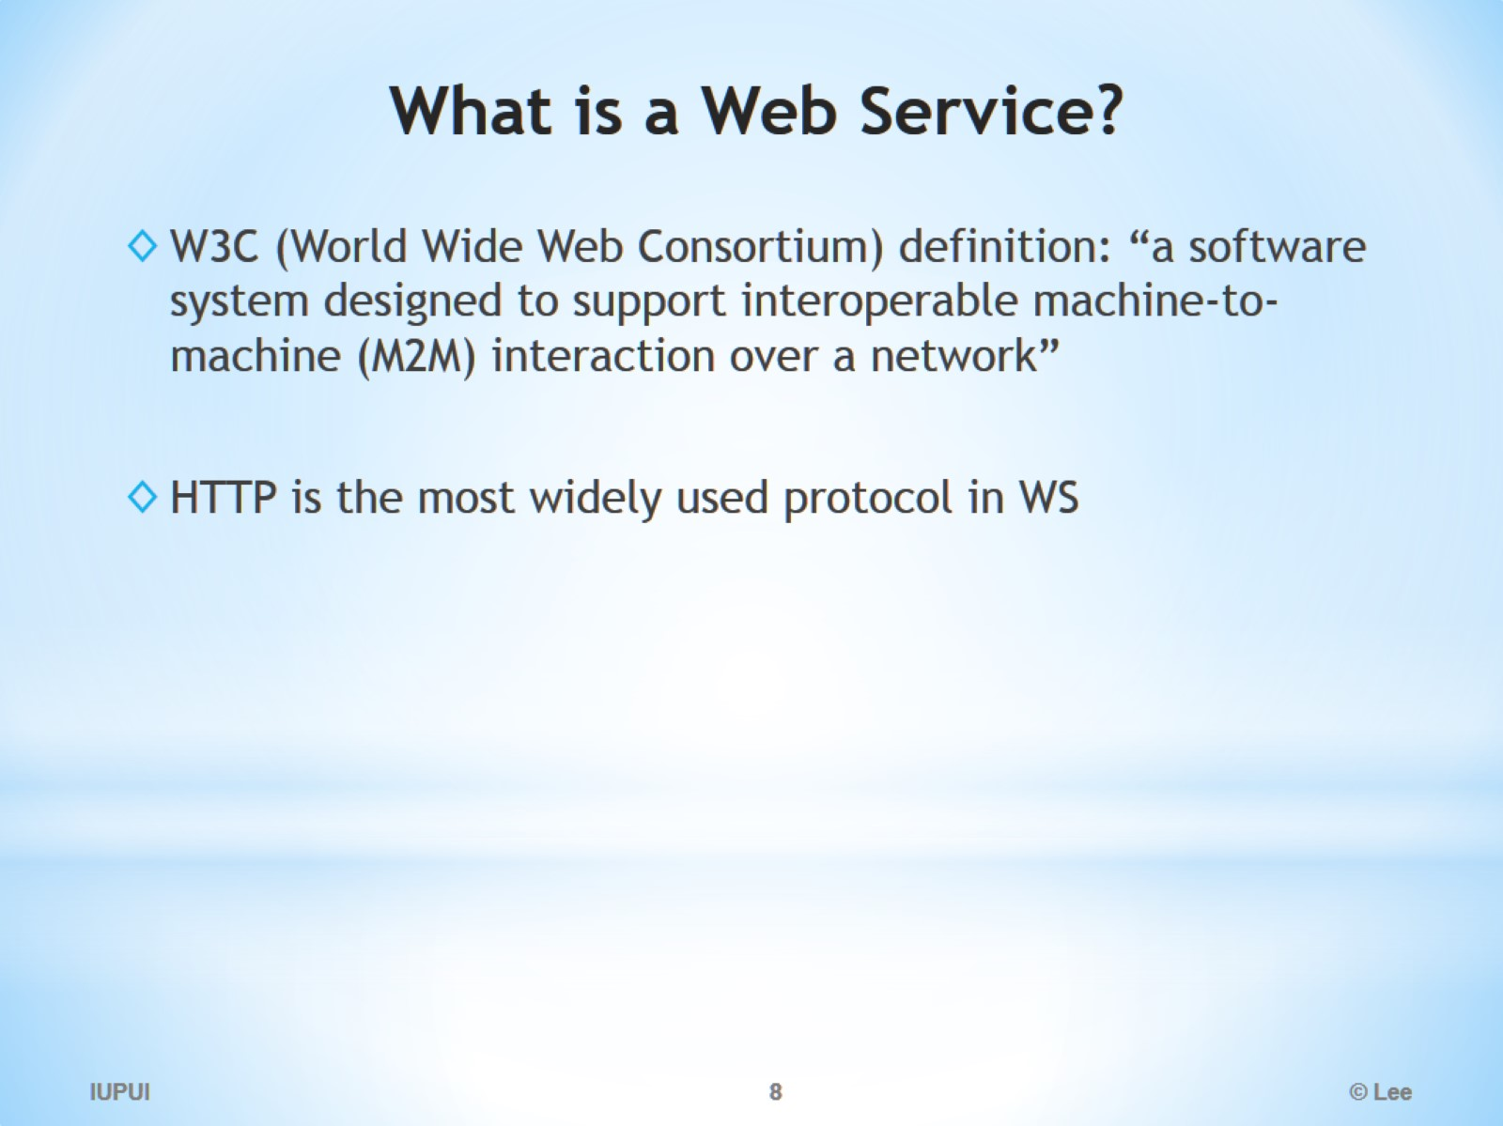
What is a Web Service?

Slide 9
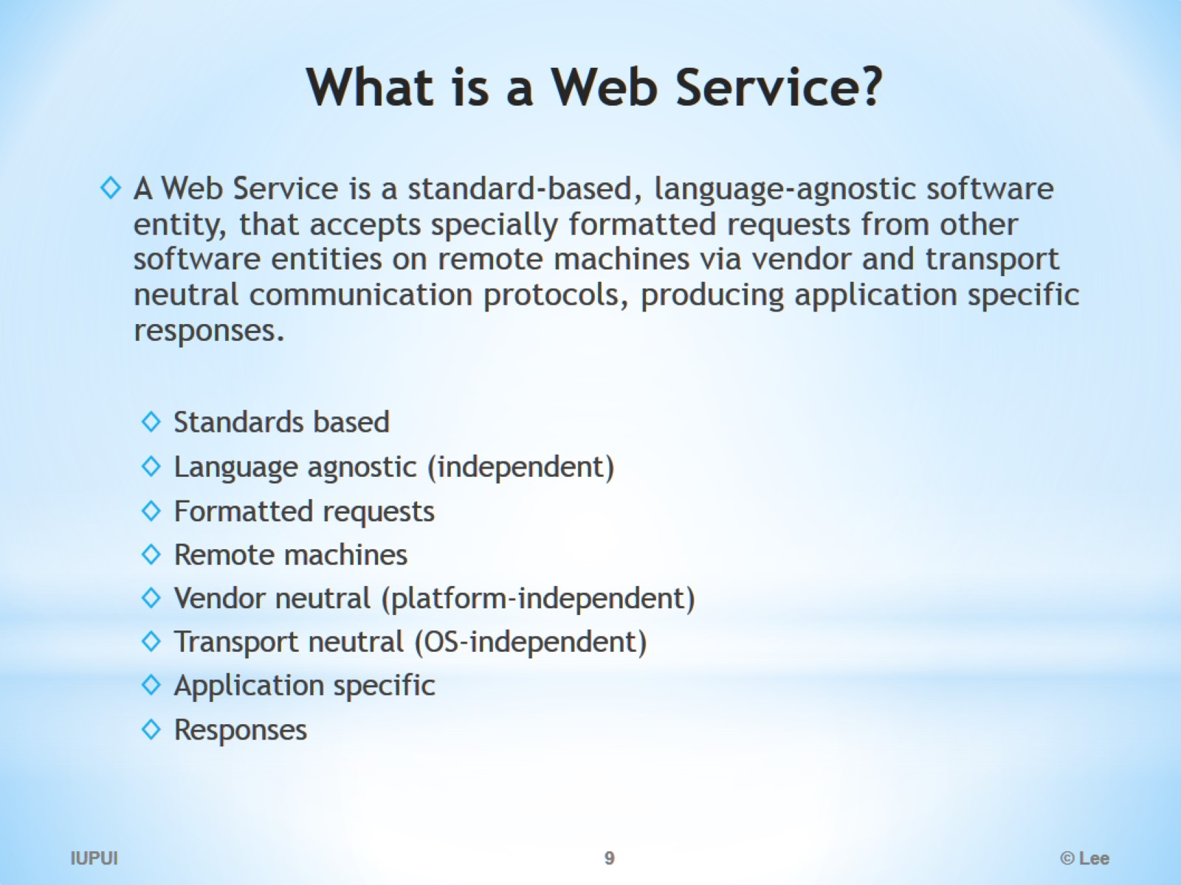
What is a Web Service?

Slide 10
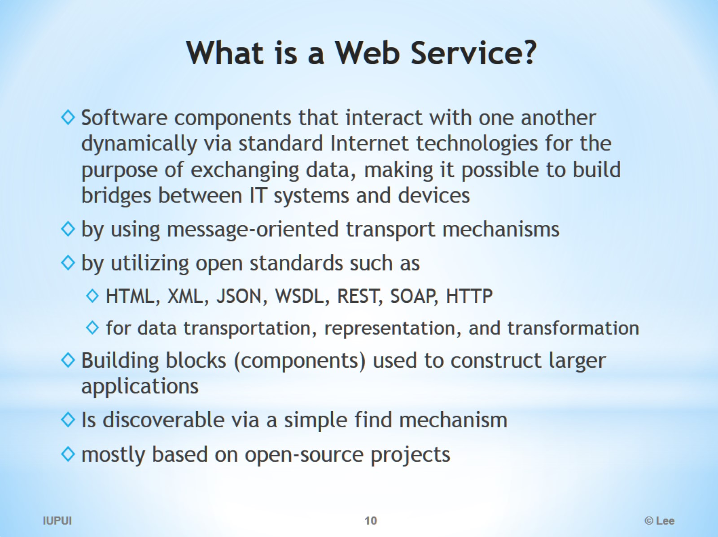
What is a Web Service?

Slide 11
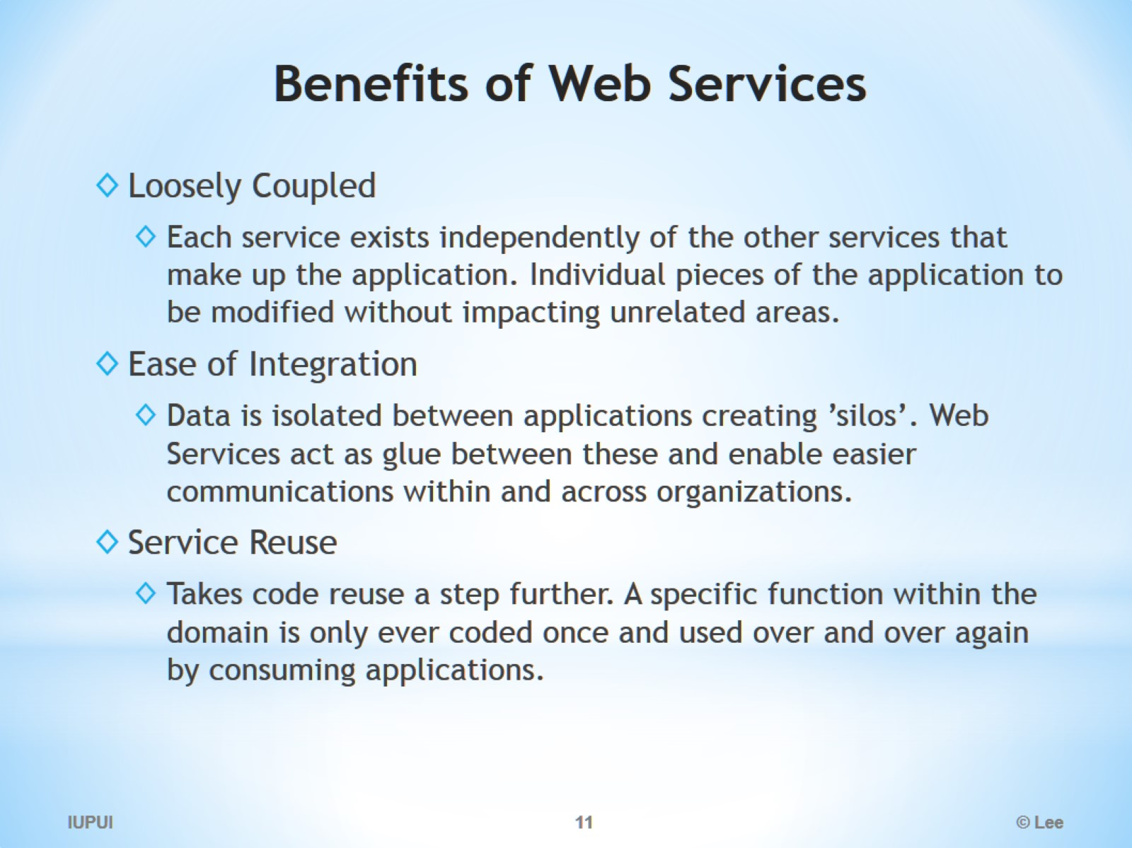
Benefits of Web Services

Slide 12
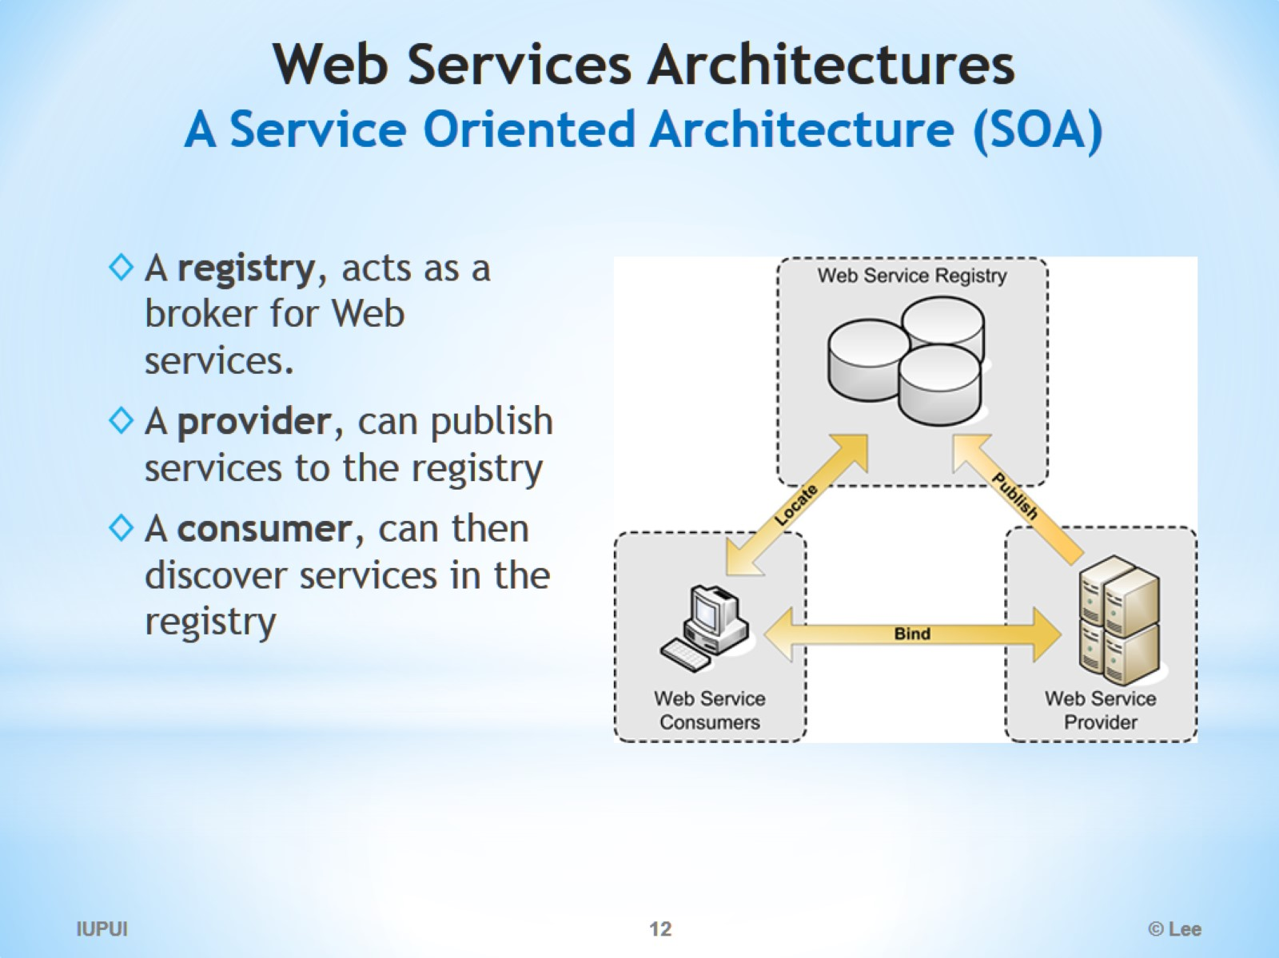
Web Services Architectures A Service Oriented Architecture (SOA)

Slide 13
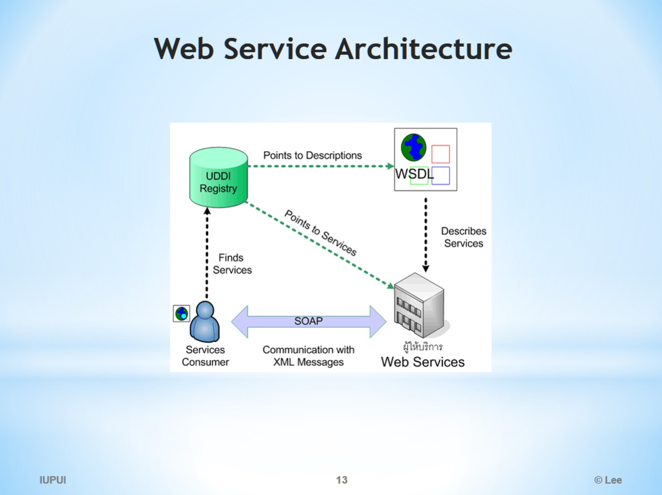
Web Service Architecture

Slide 14
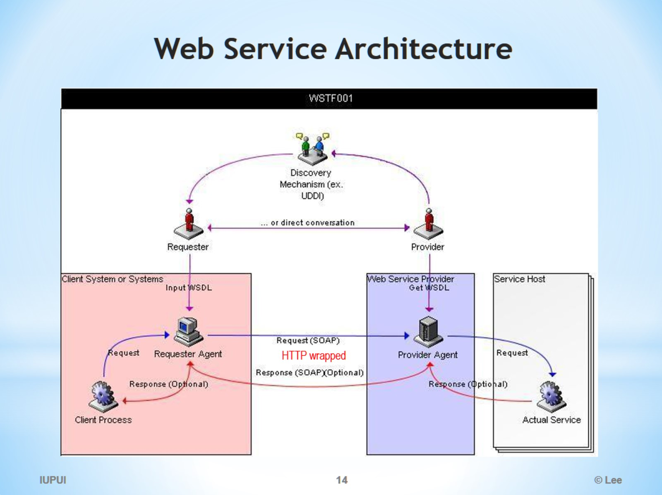
Web Service Architecture

Slide 15
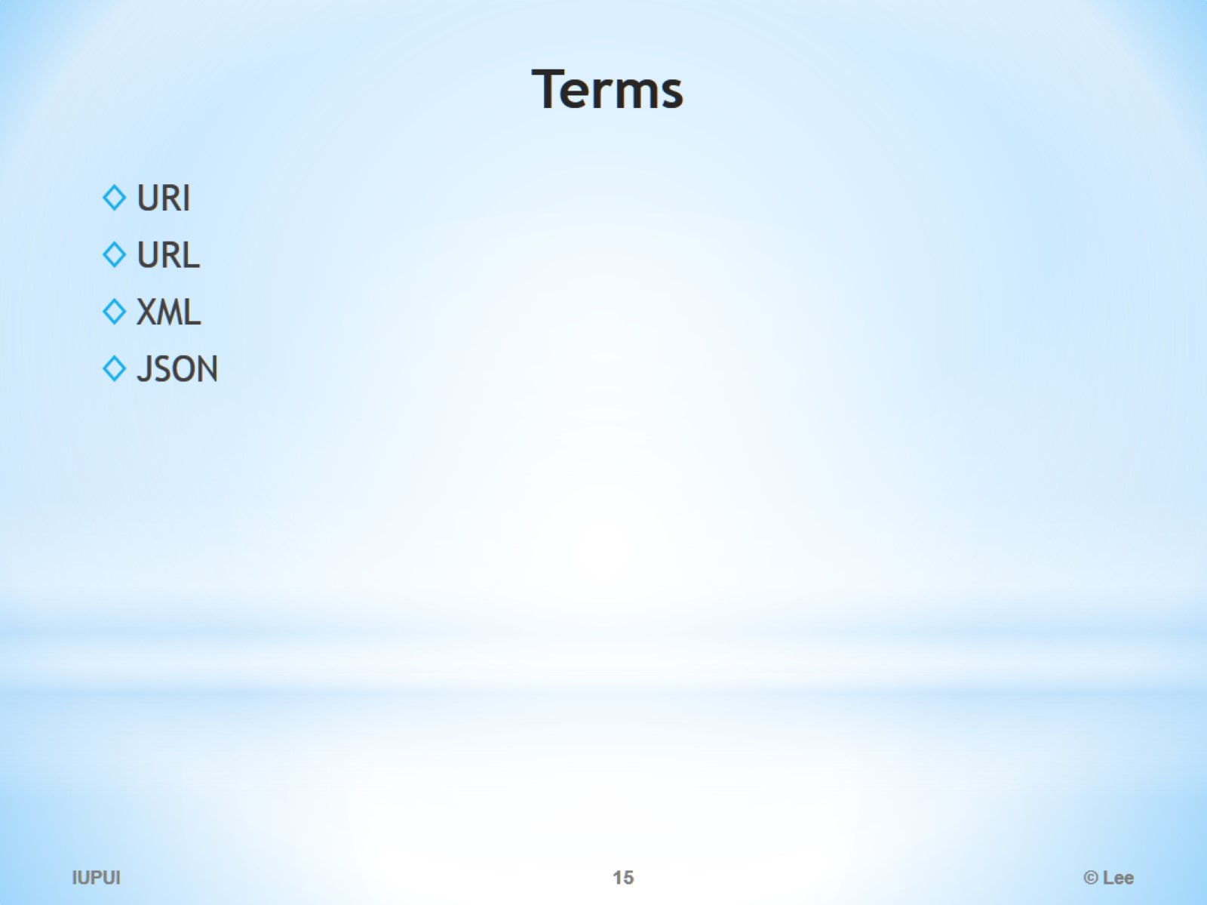
Terms

Slide 16
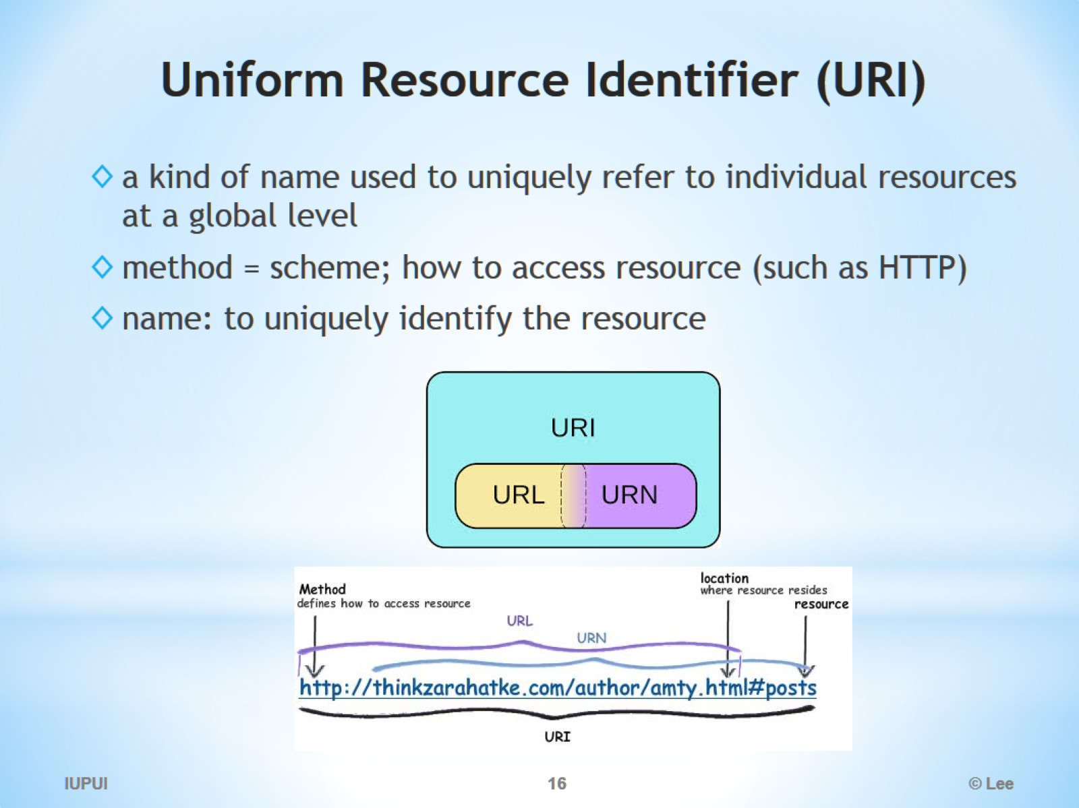
Uniform Resource Identifier (URI)

Slide 17
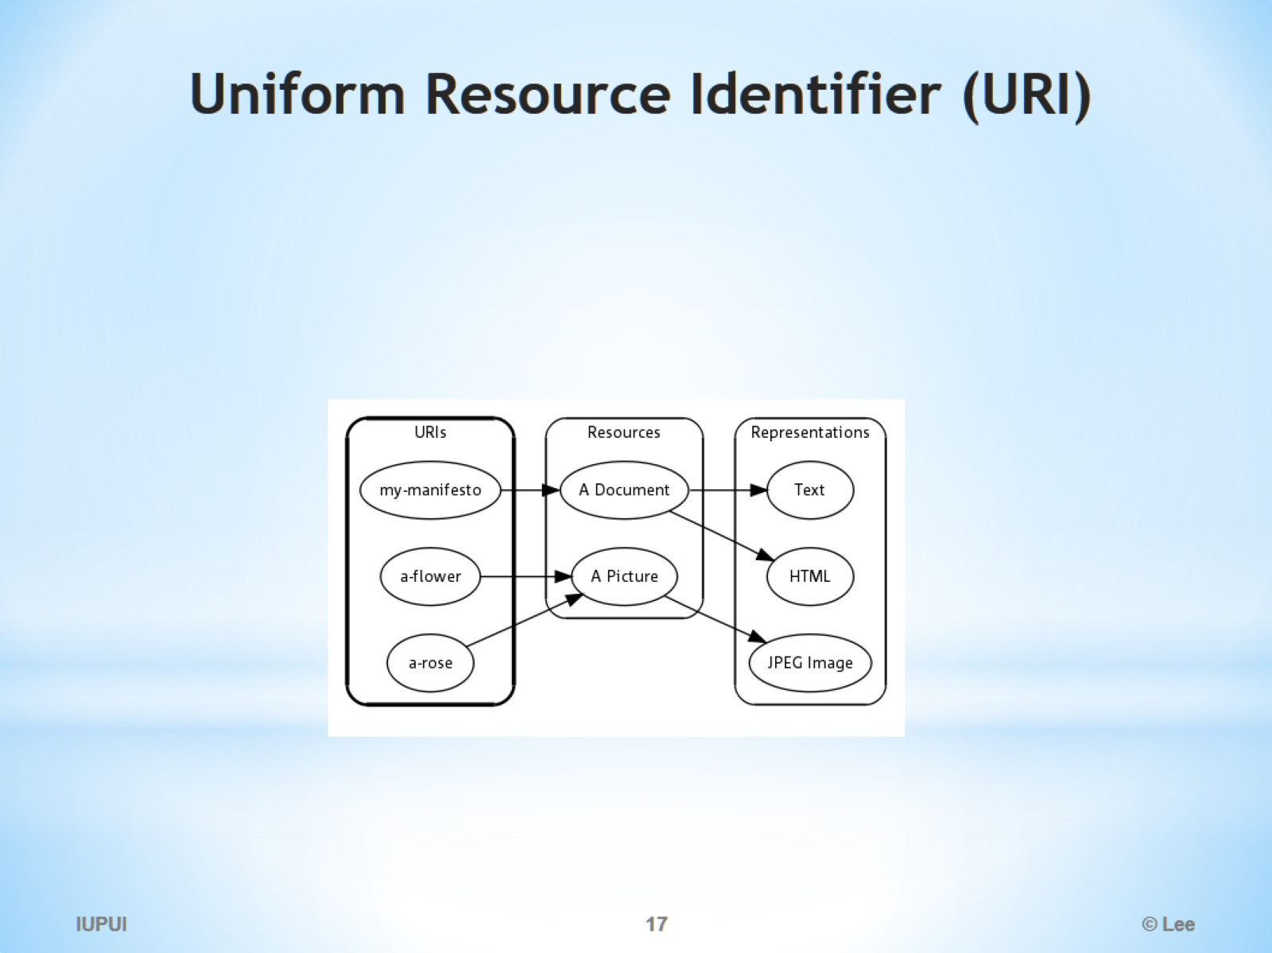
Uniform Resource Identifier (URI)

Slide 18
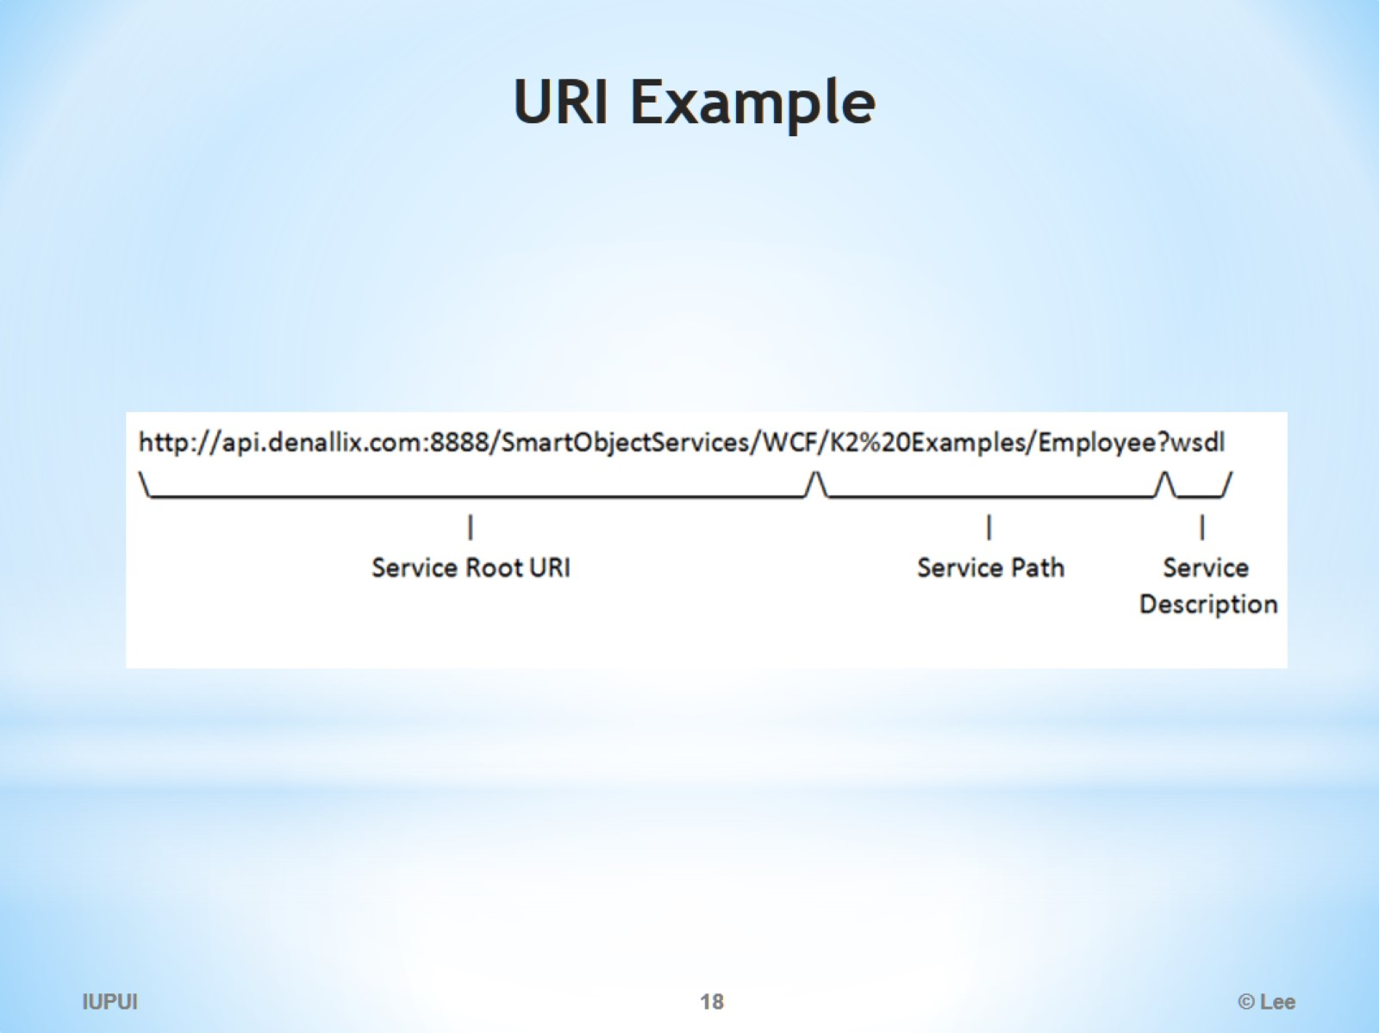
URI Example

Slide 19
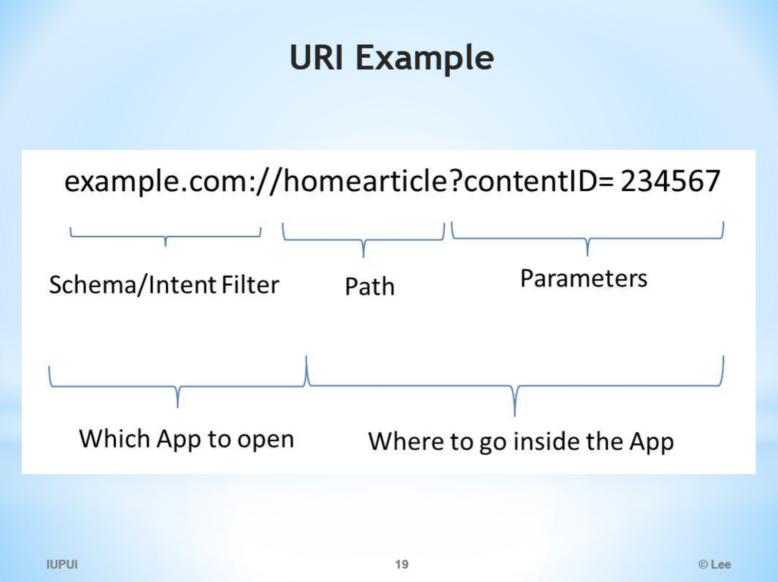
URI Example

Slide 20
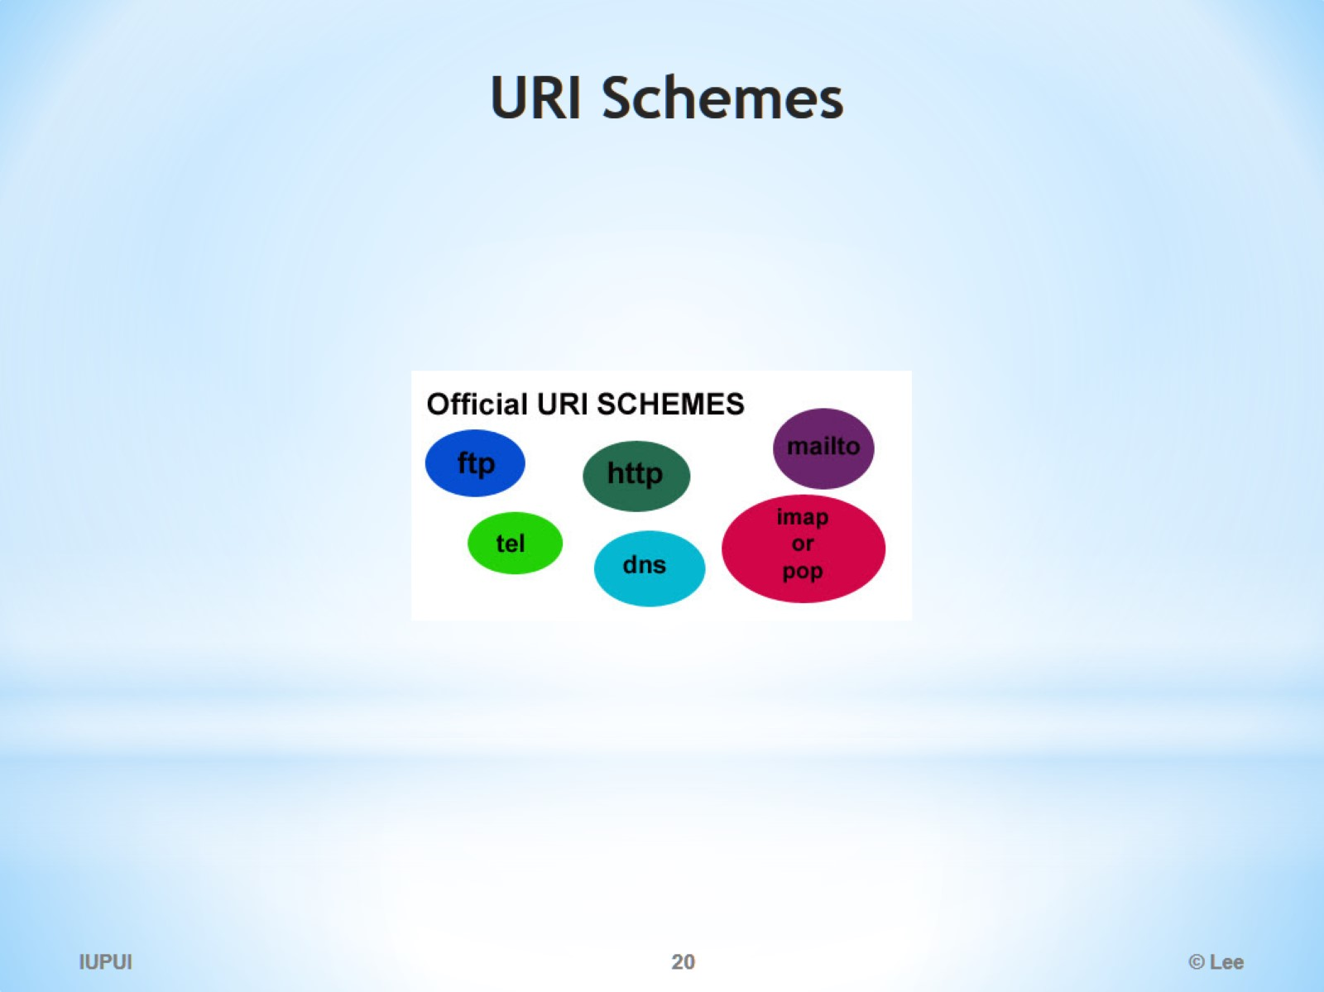
URI Schemes

Slide 21
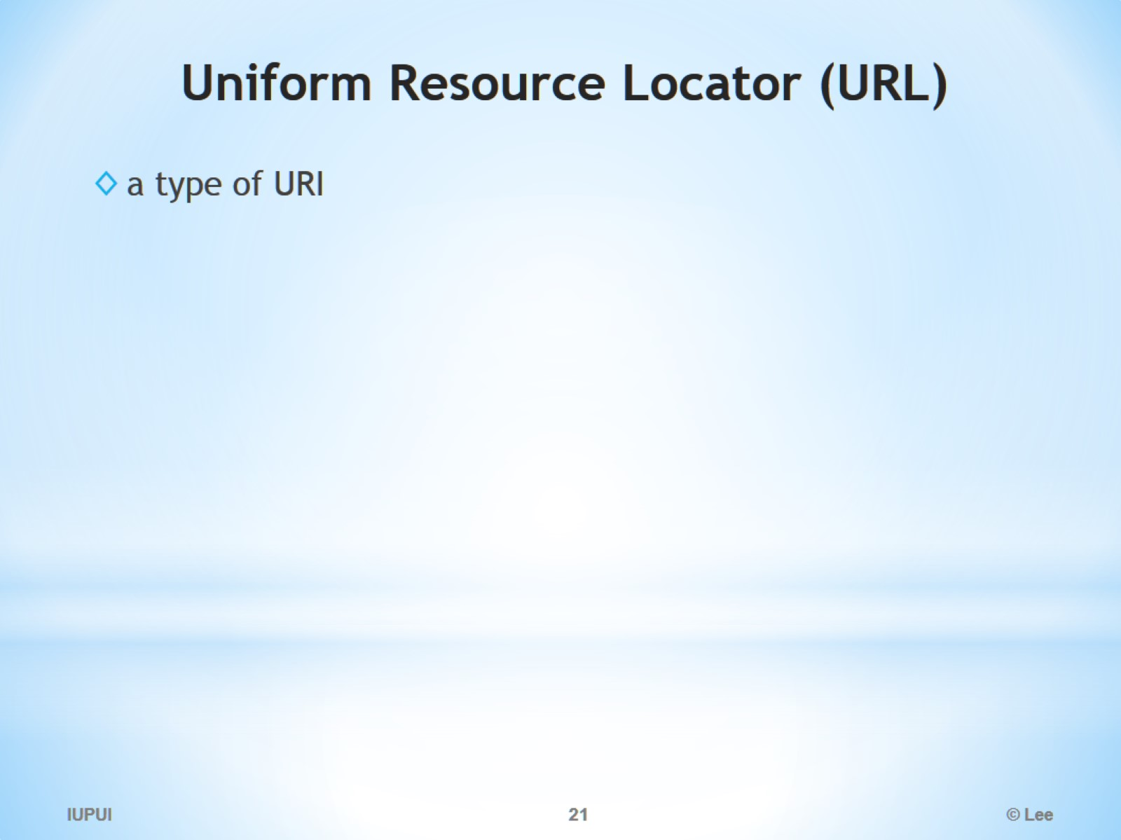
Uni­form Re­source Lo­ca­tor (URL)

Slide 22
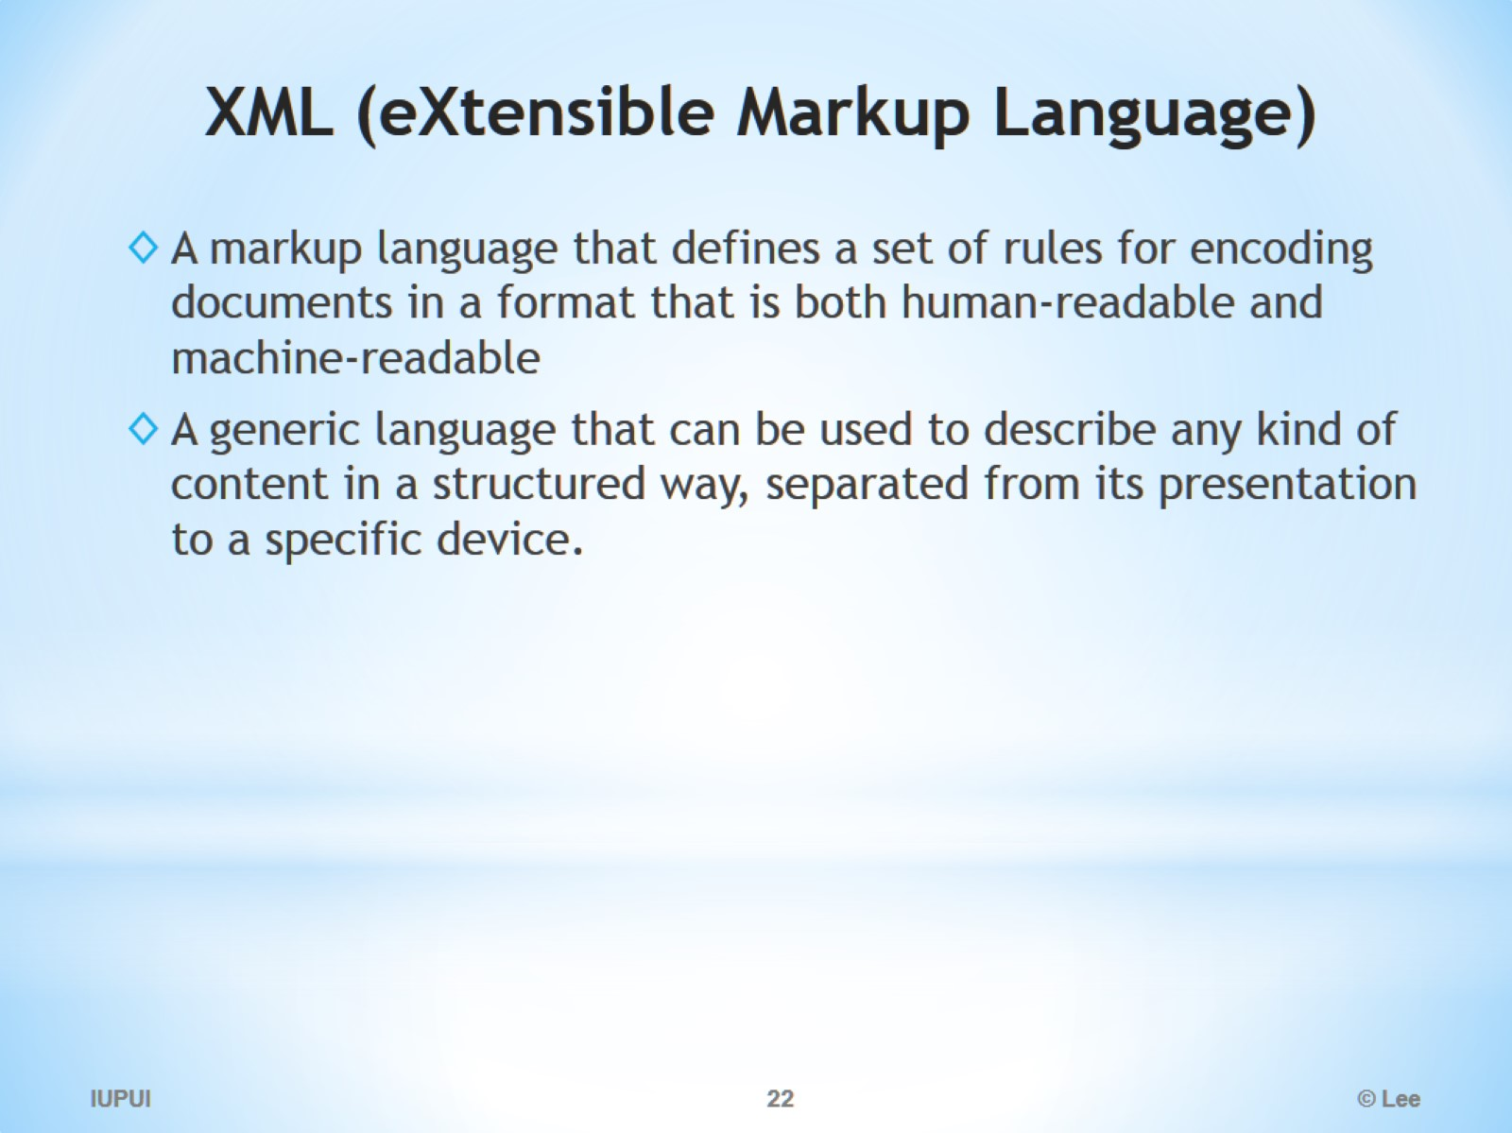
XML (eXtensible Markup Language)

Slide 23
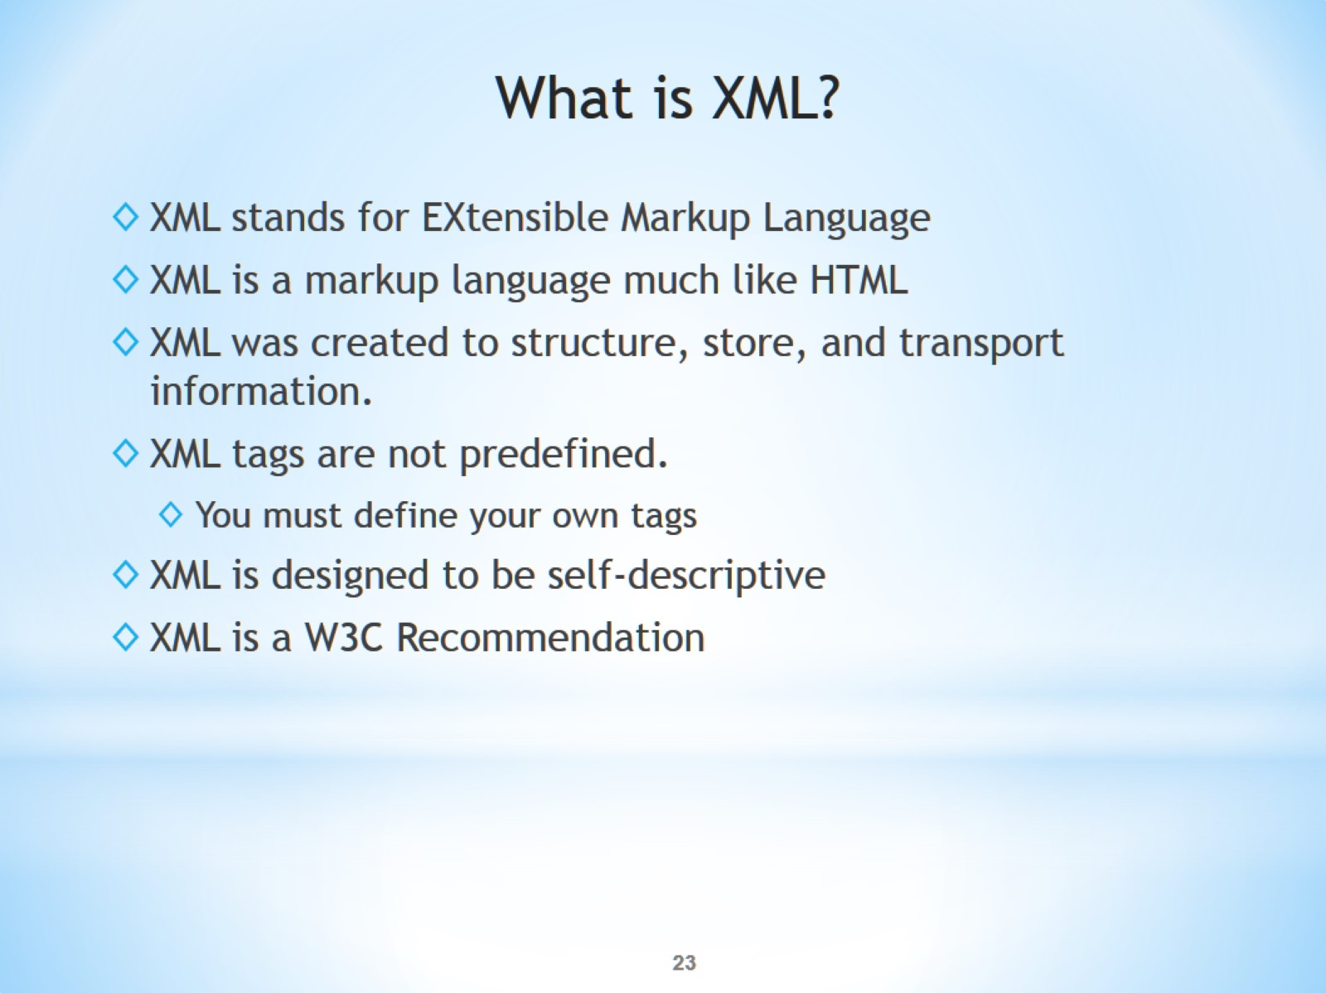
What is XML?

Slide 24
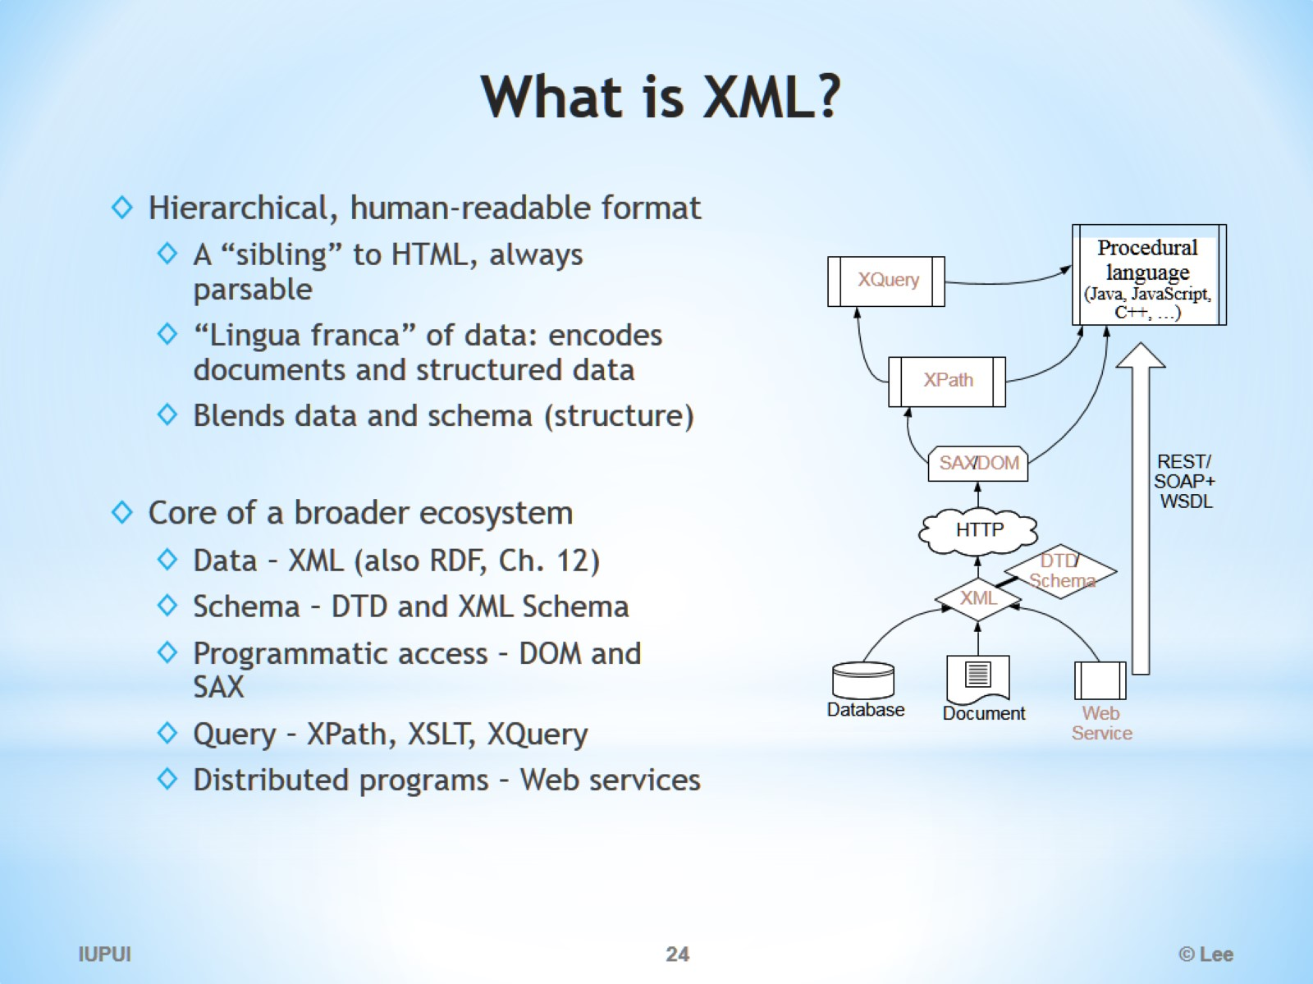
What is XML?

Slide 25
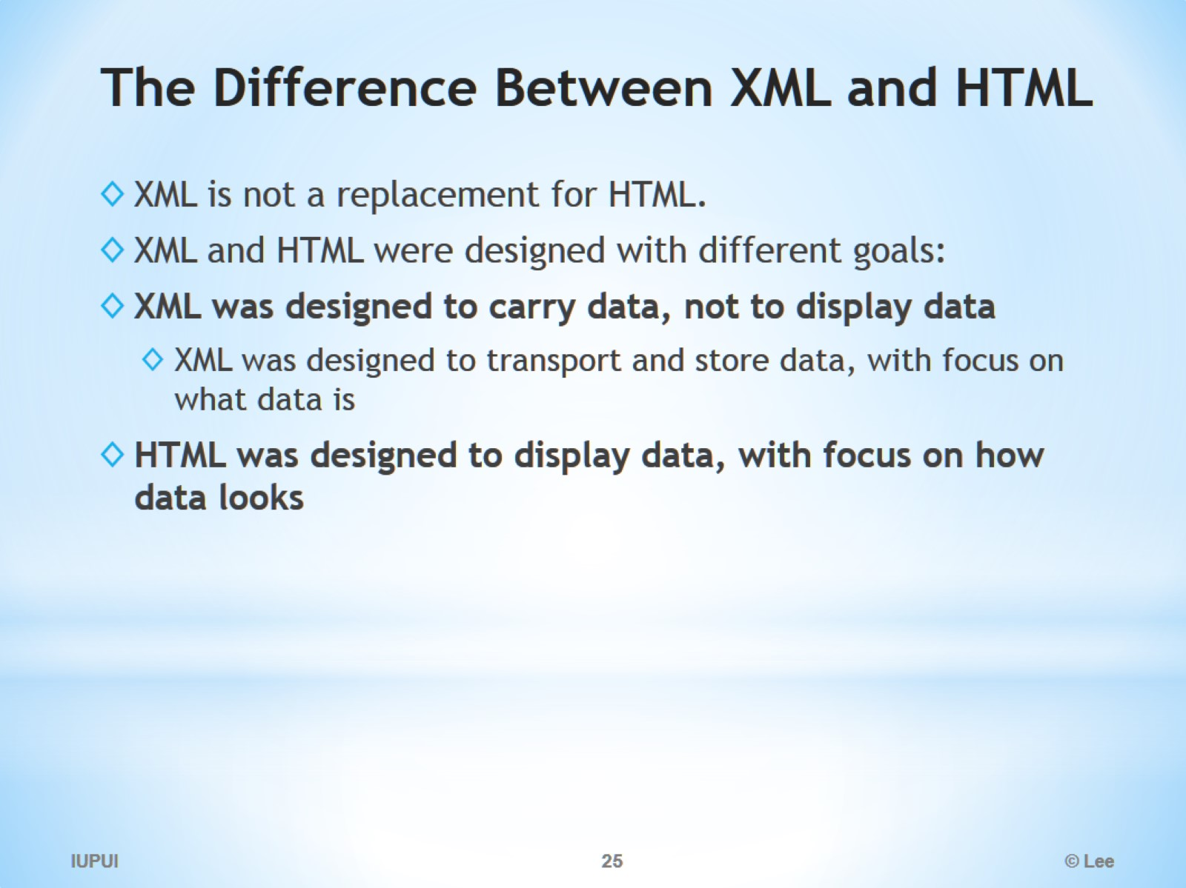
The Difference Between XML and HTML

Slide 26
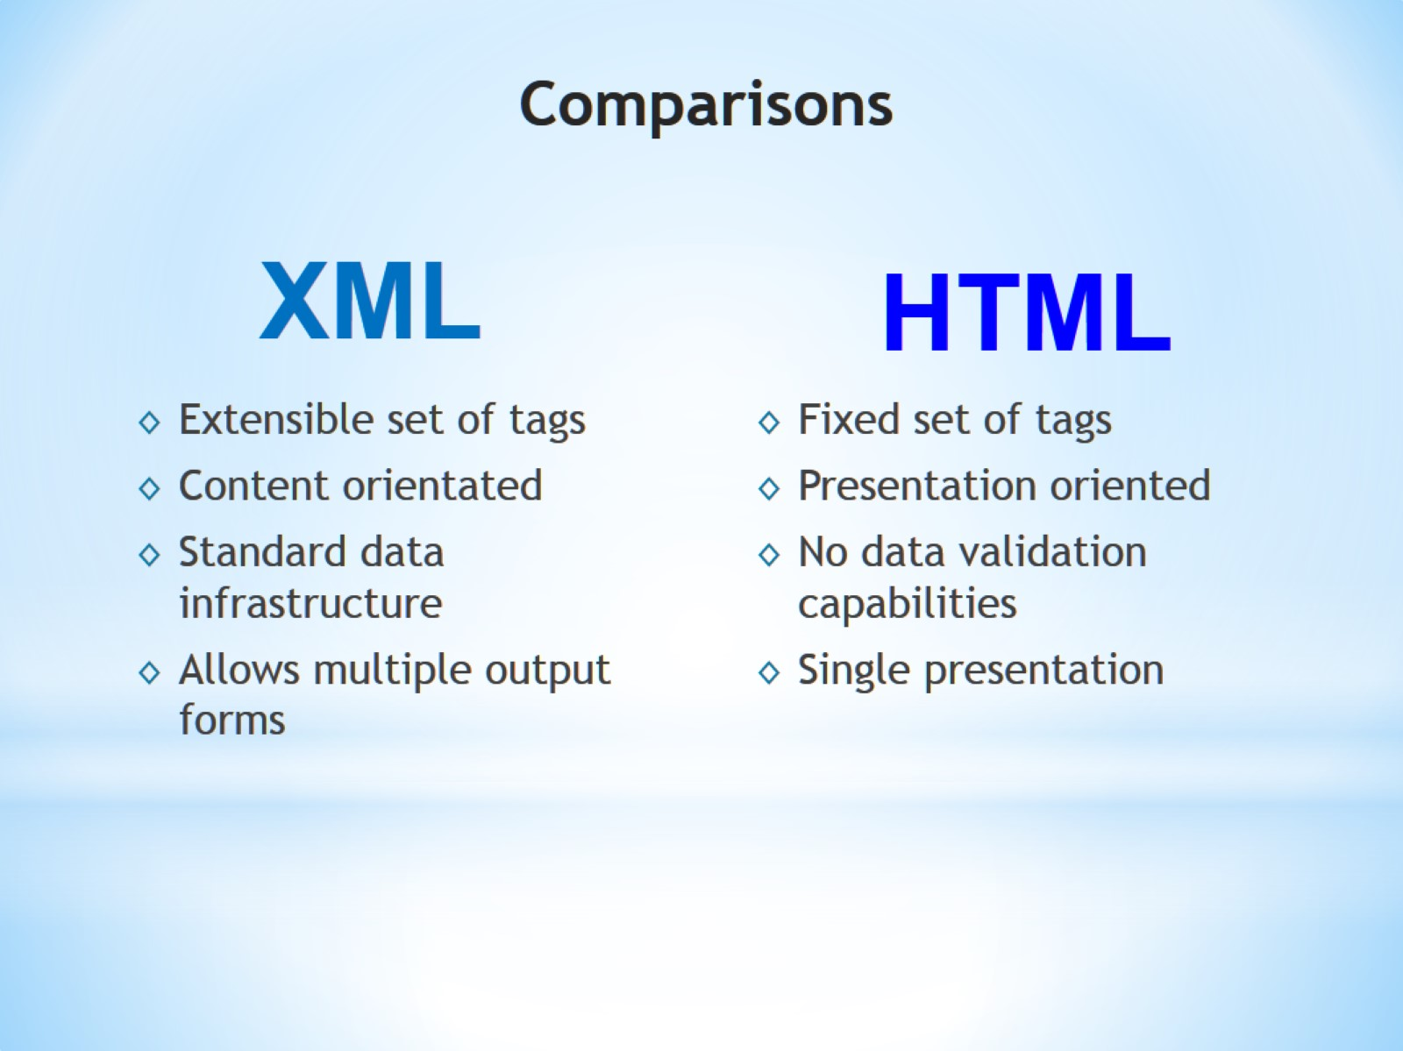
Comparisons

Slide 27
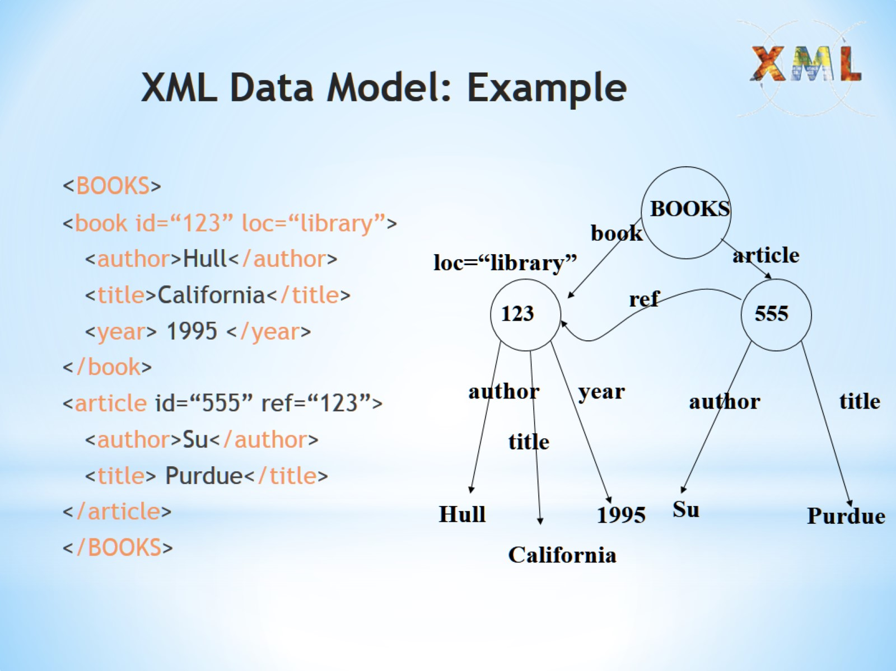
XML Data Model: Example

Slide 28
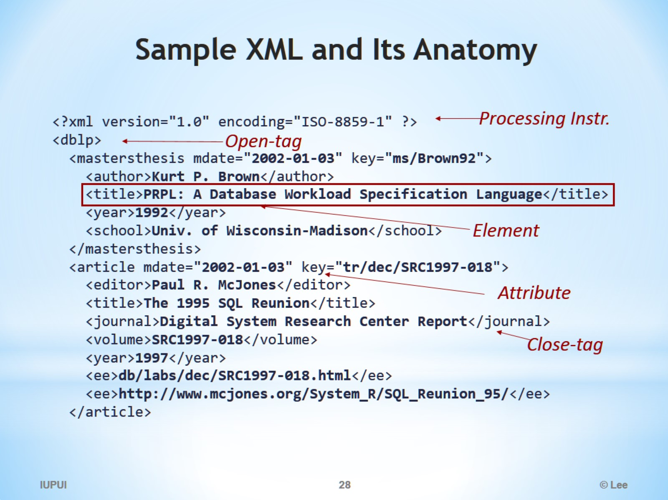
Sample XML and Its Anatomy

Slide 29
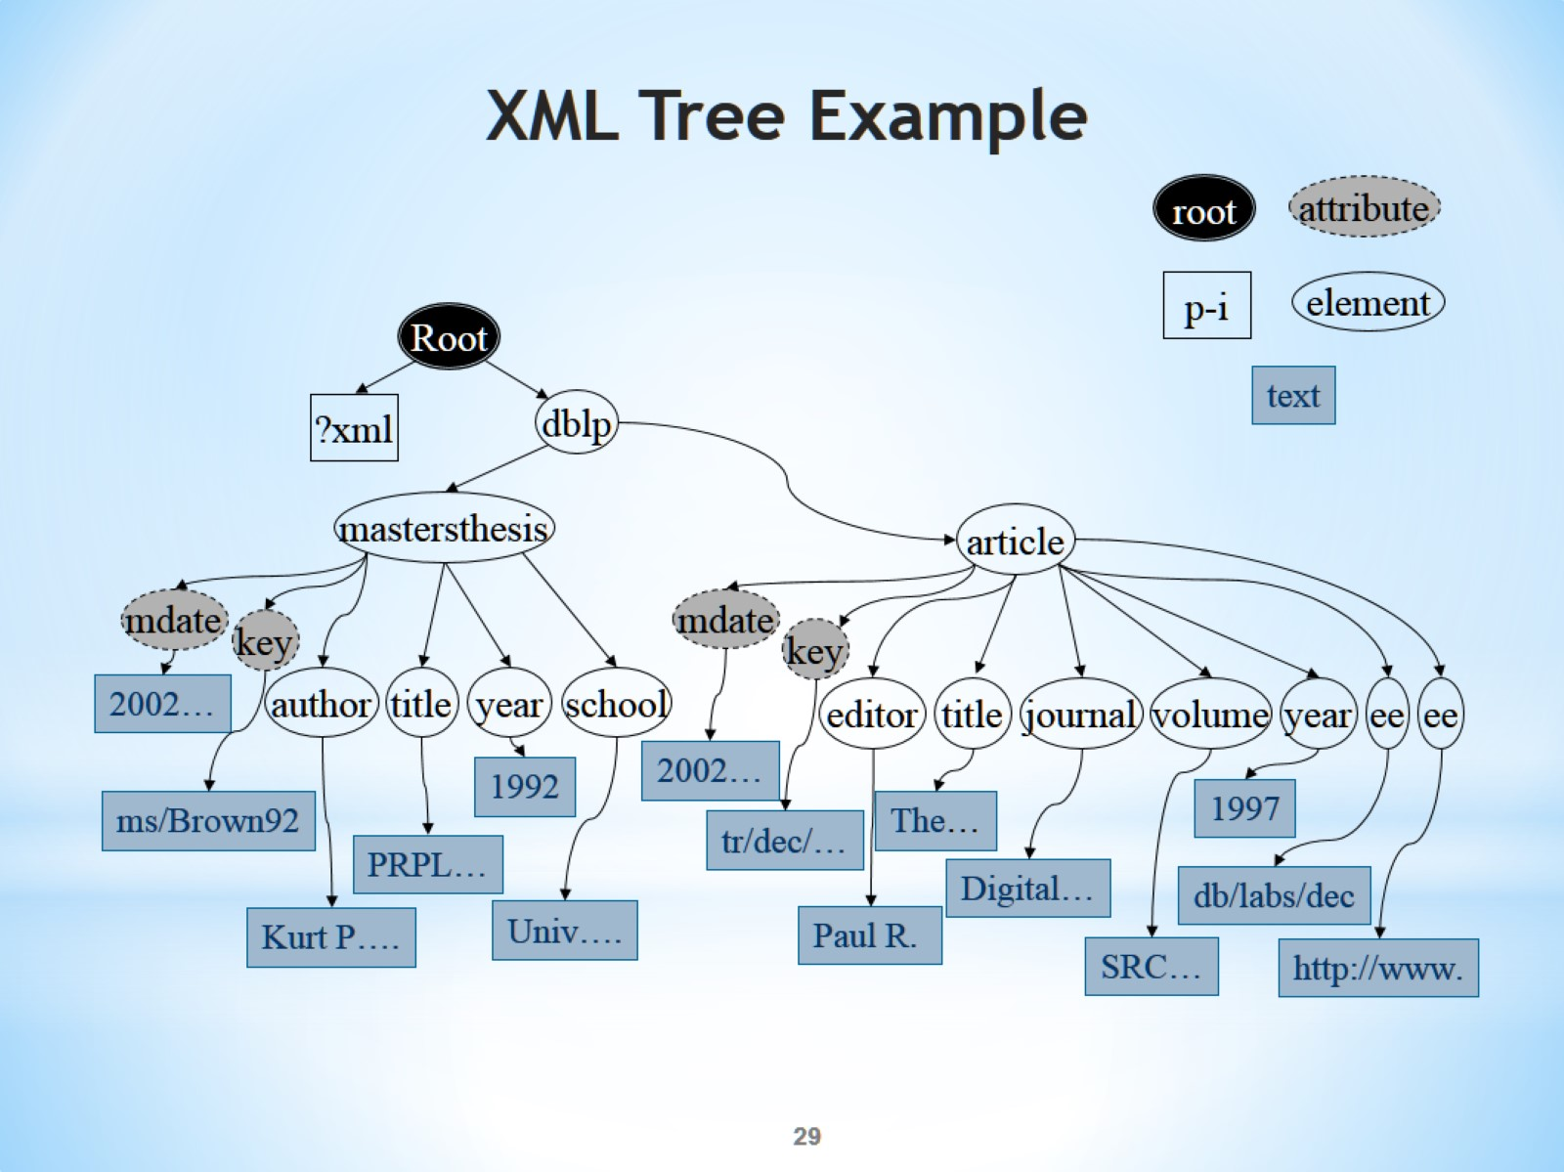
XML Tree Example

Slide 30
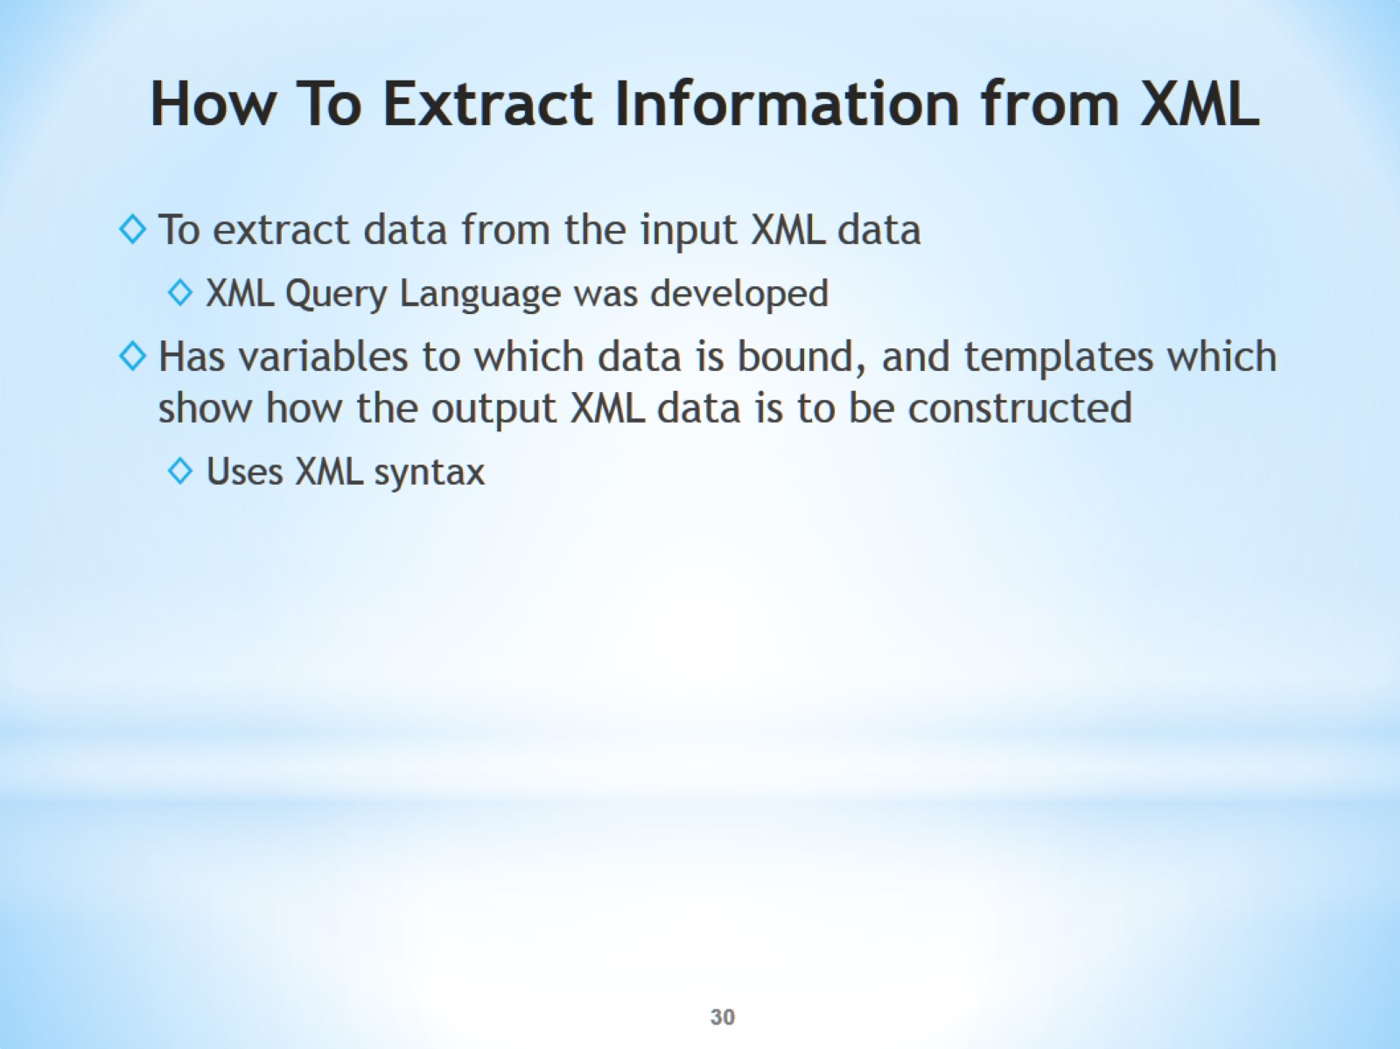
How To Extract Information from XML

Slide 31
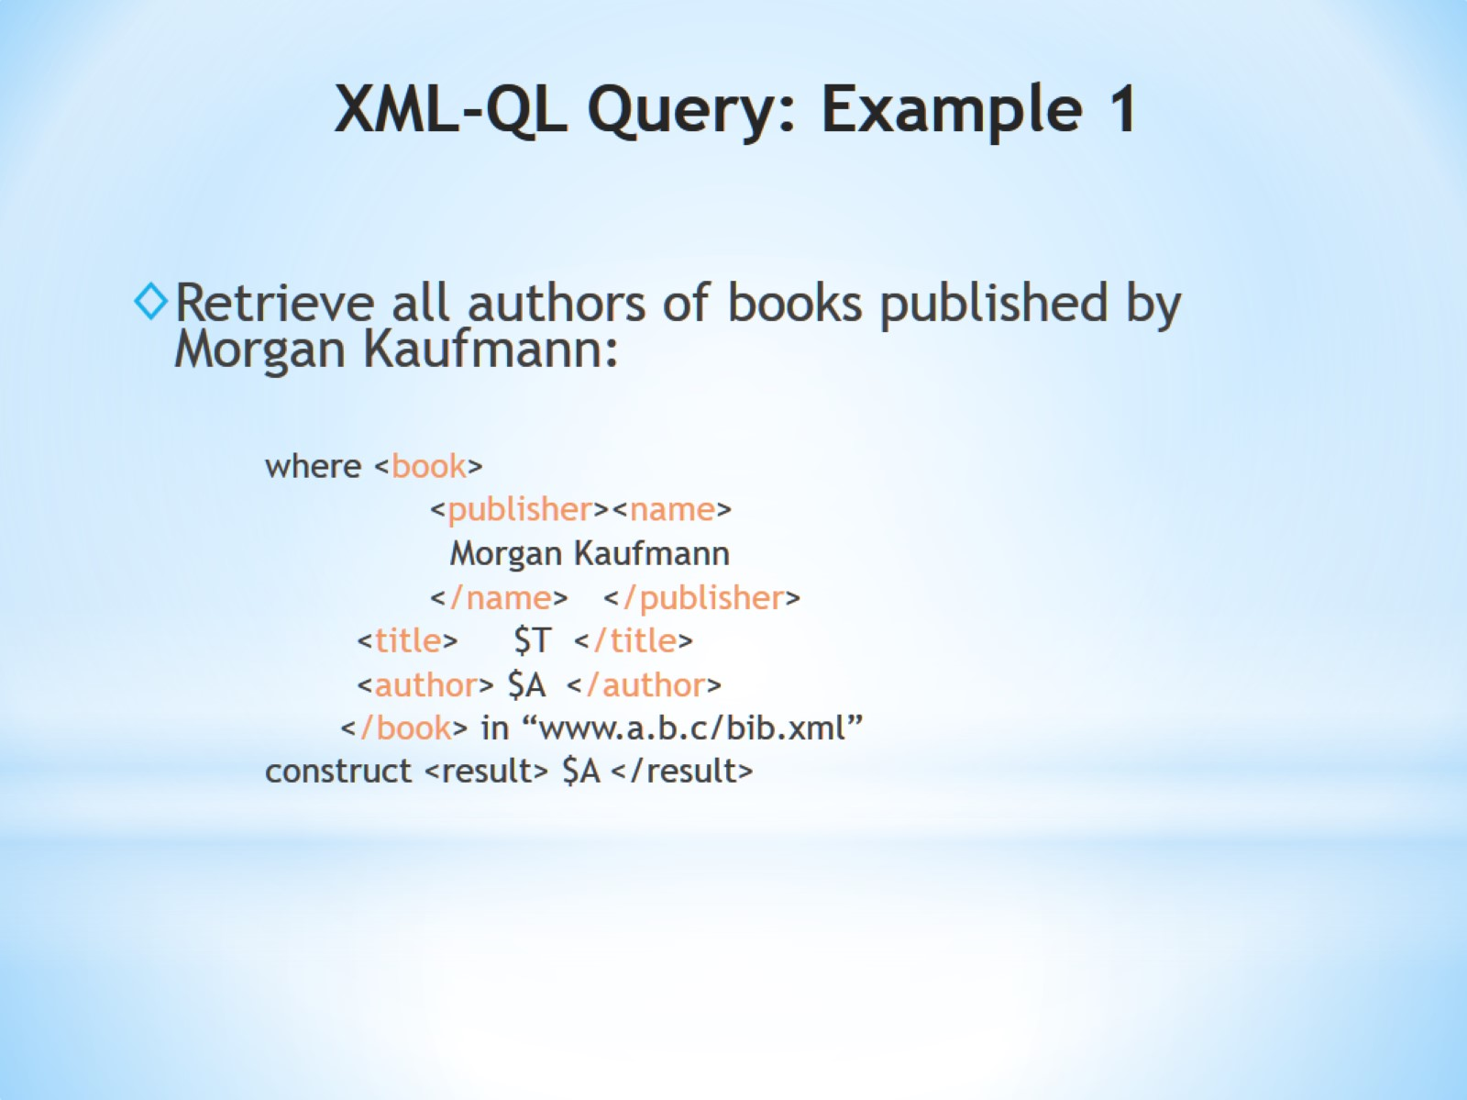
XML-QL Query: Example 1

Slide 32
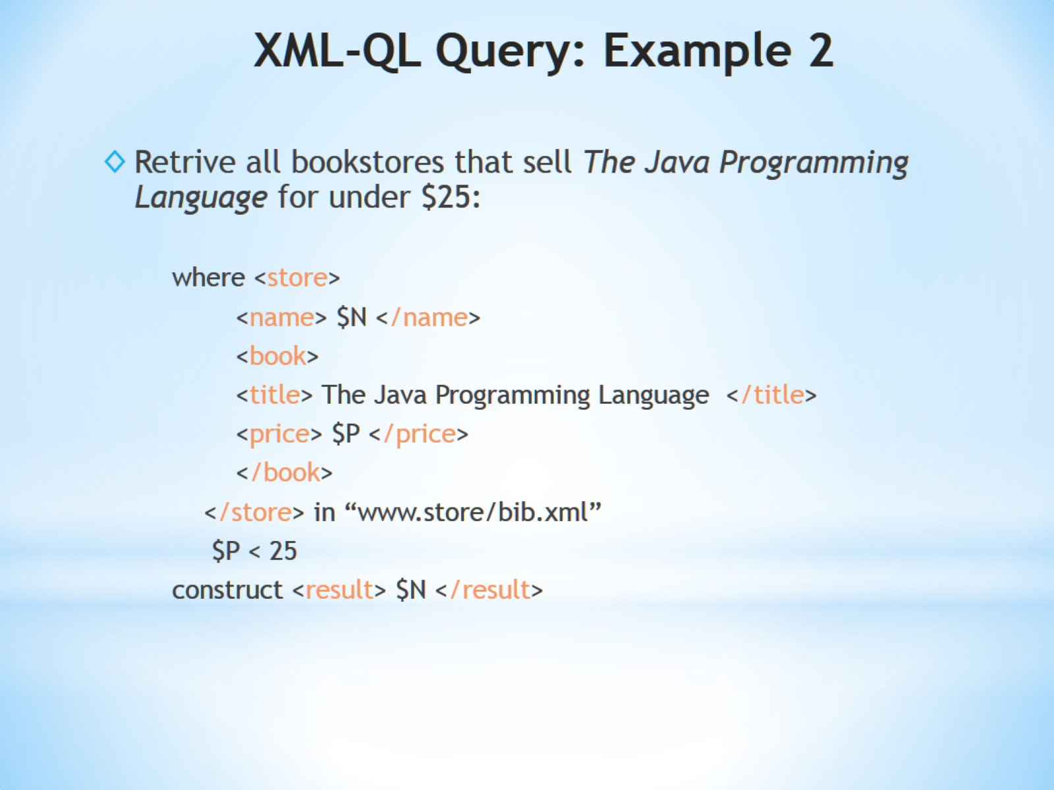
XML-QL Query: Example 2

Slide 33
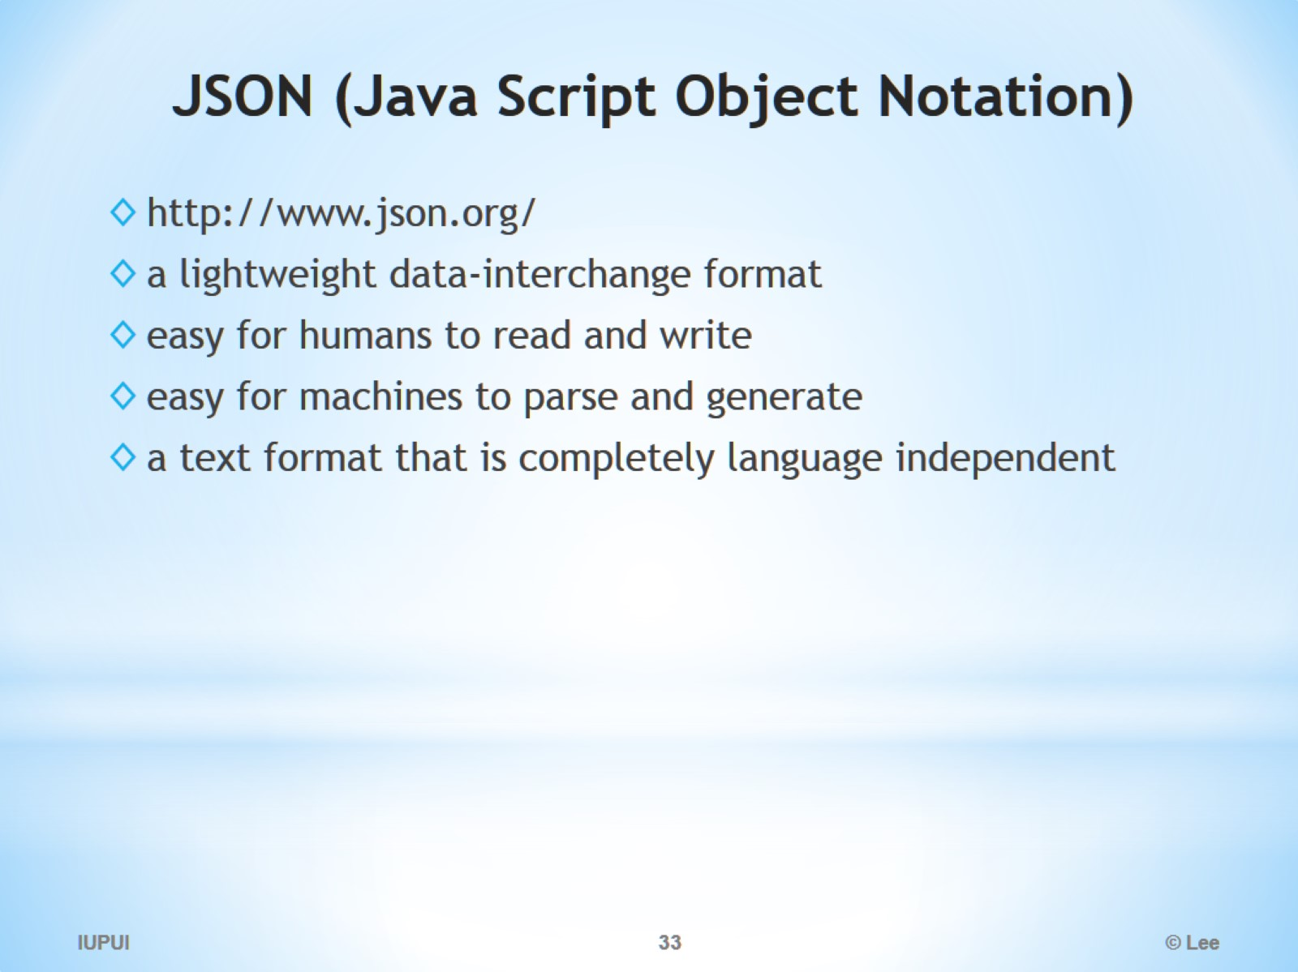
JSON (Java Script Object Notation)

Slide 34
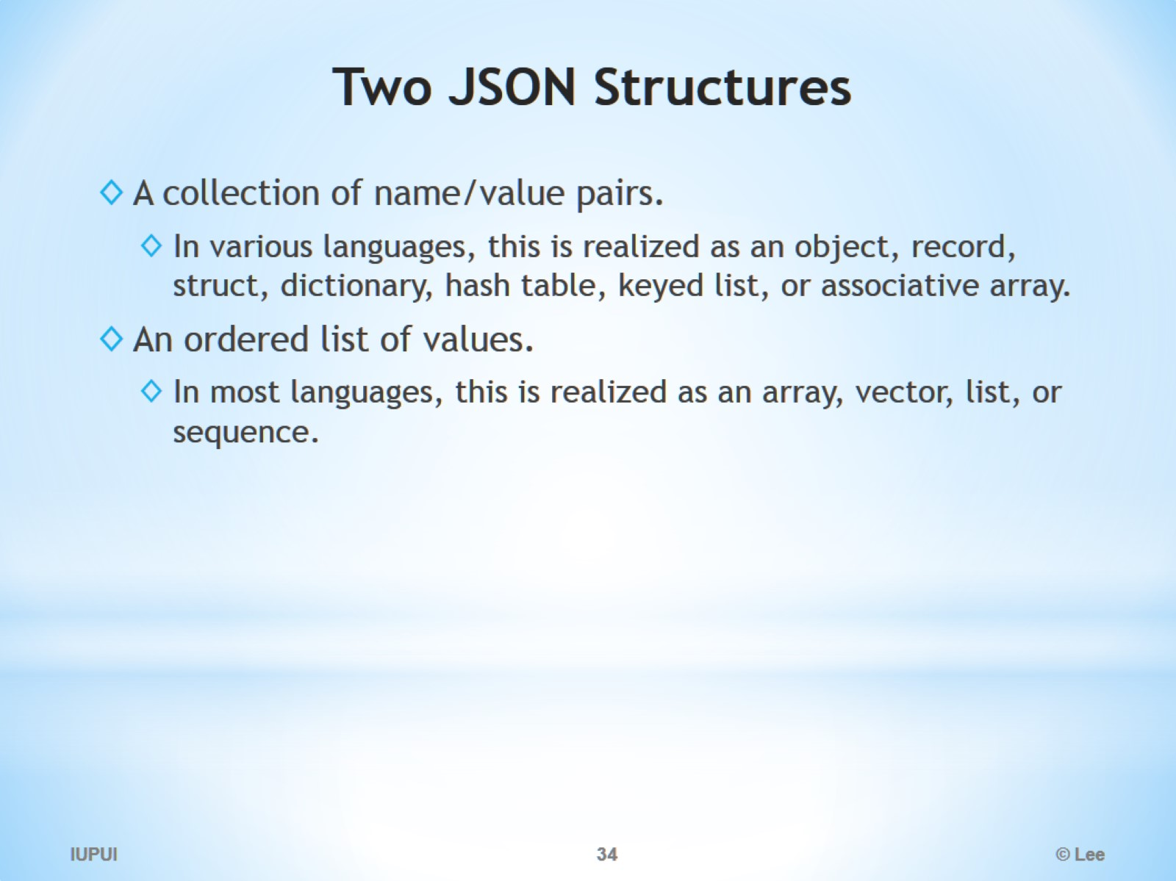
Two JSON Structures

Slide 35
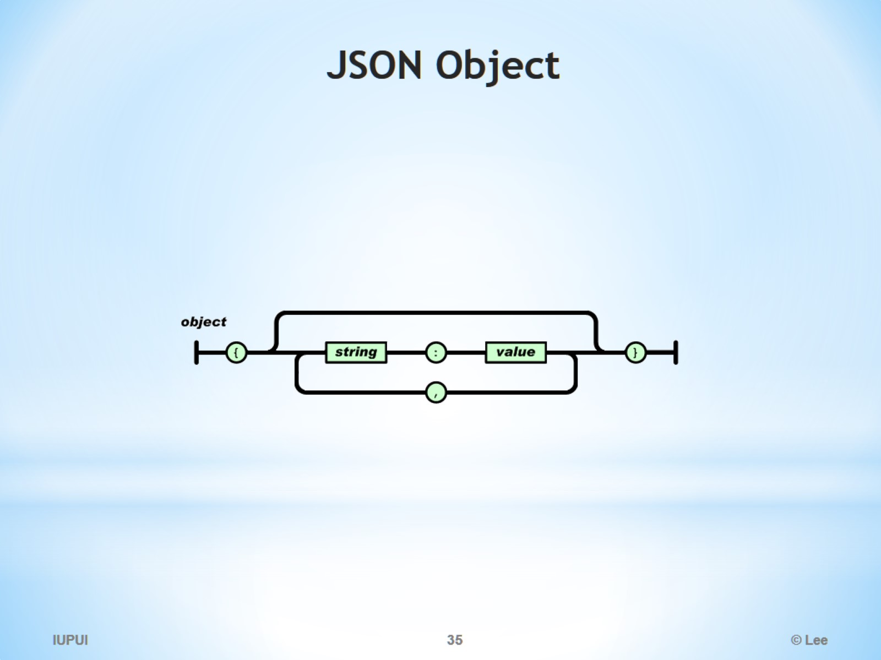
JSON Object

Slide 36
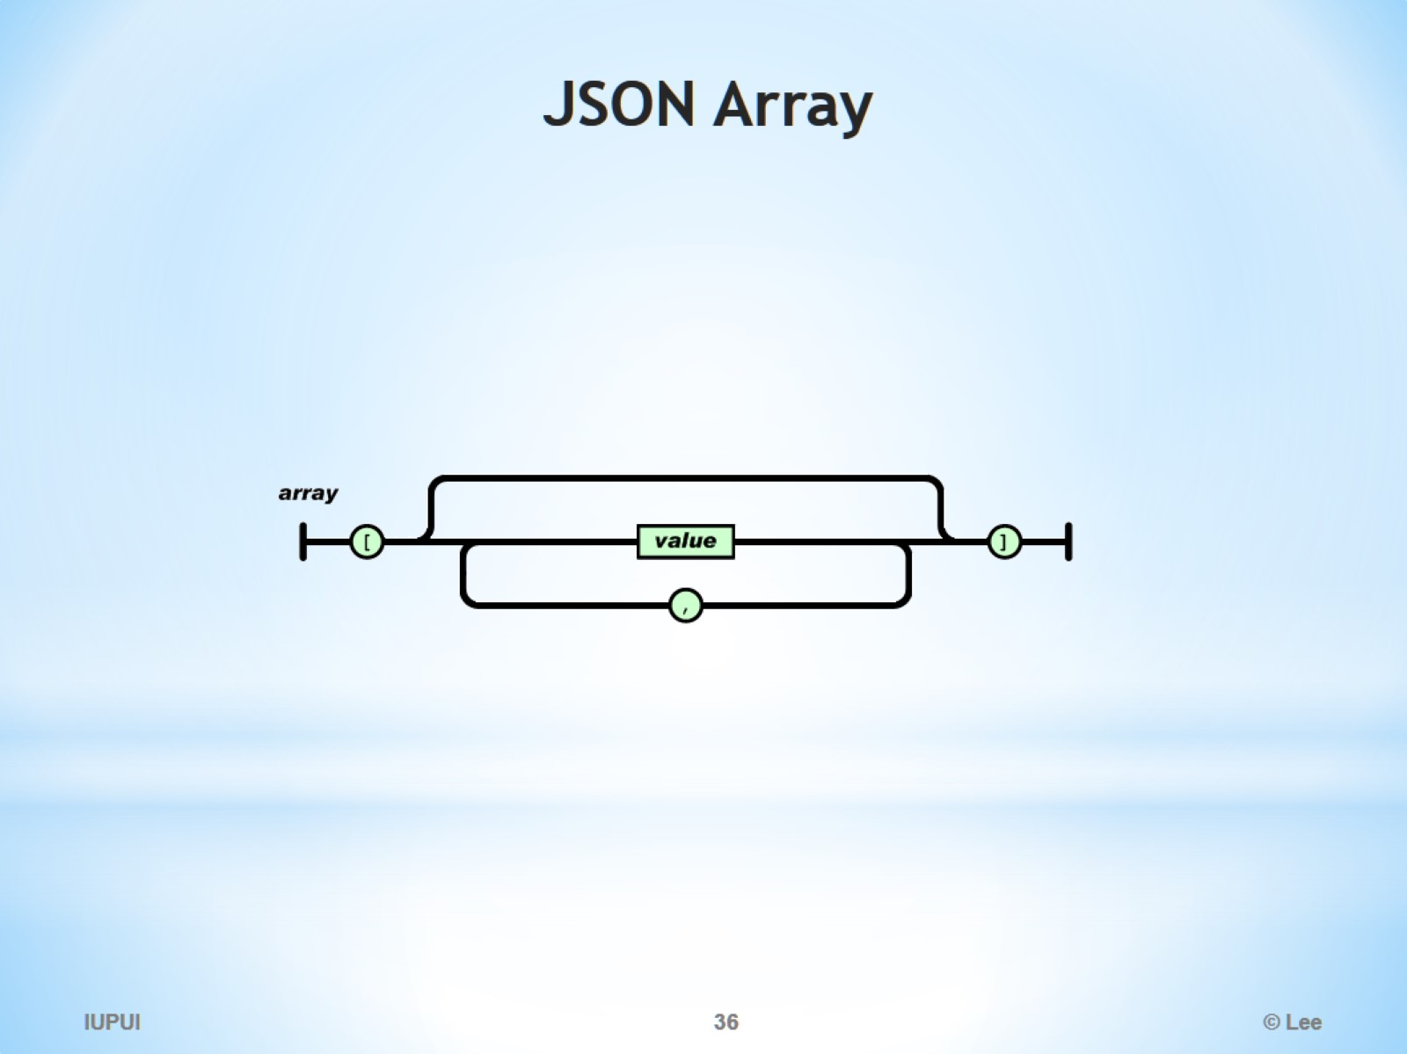
JSON Array

Slide 37
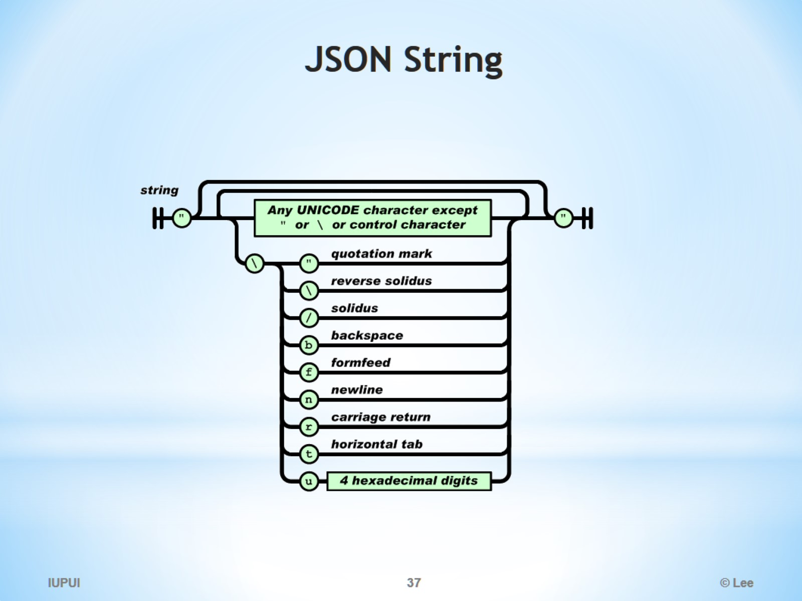
JSON String

Slide 38
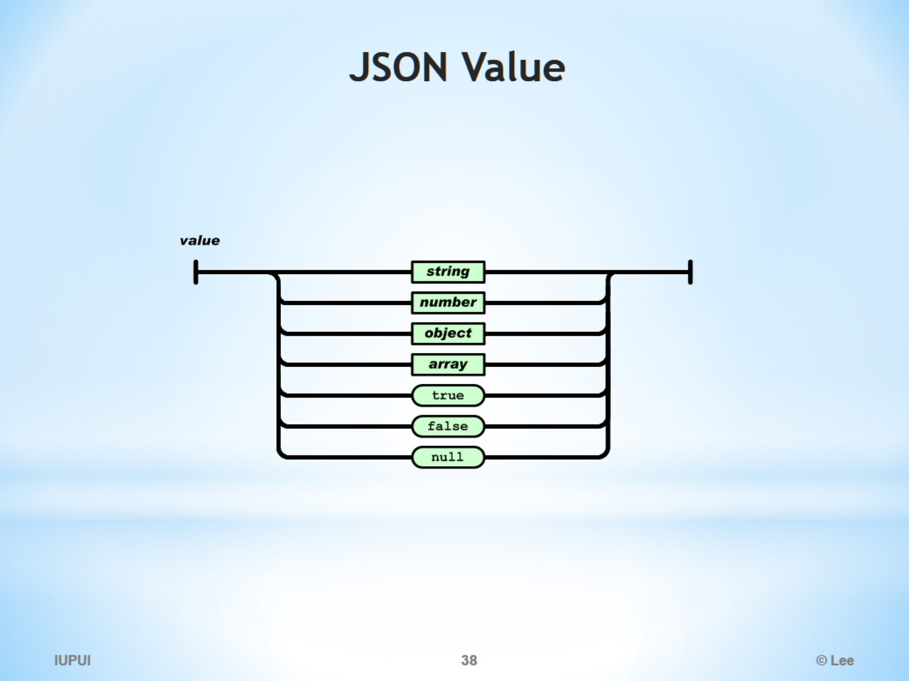
JSON Value

Slide 39
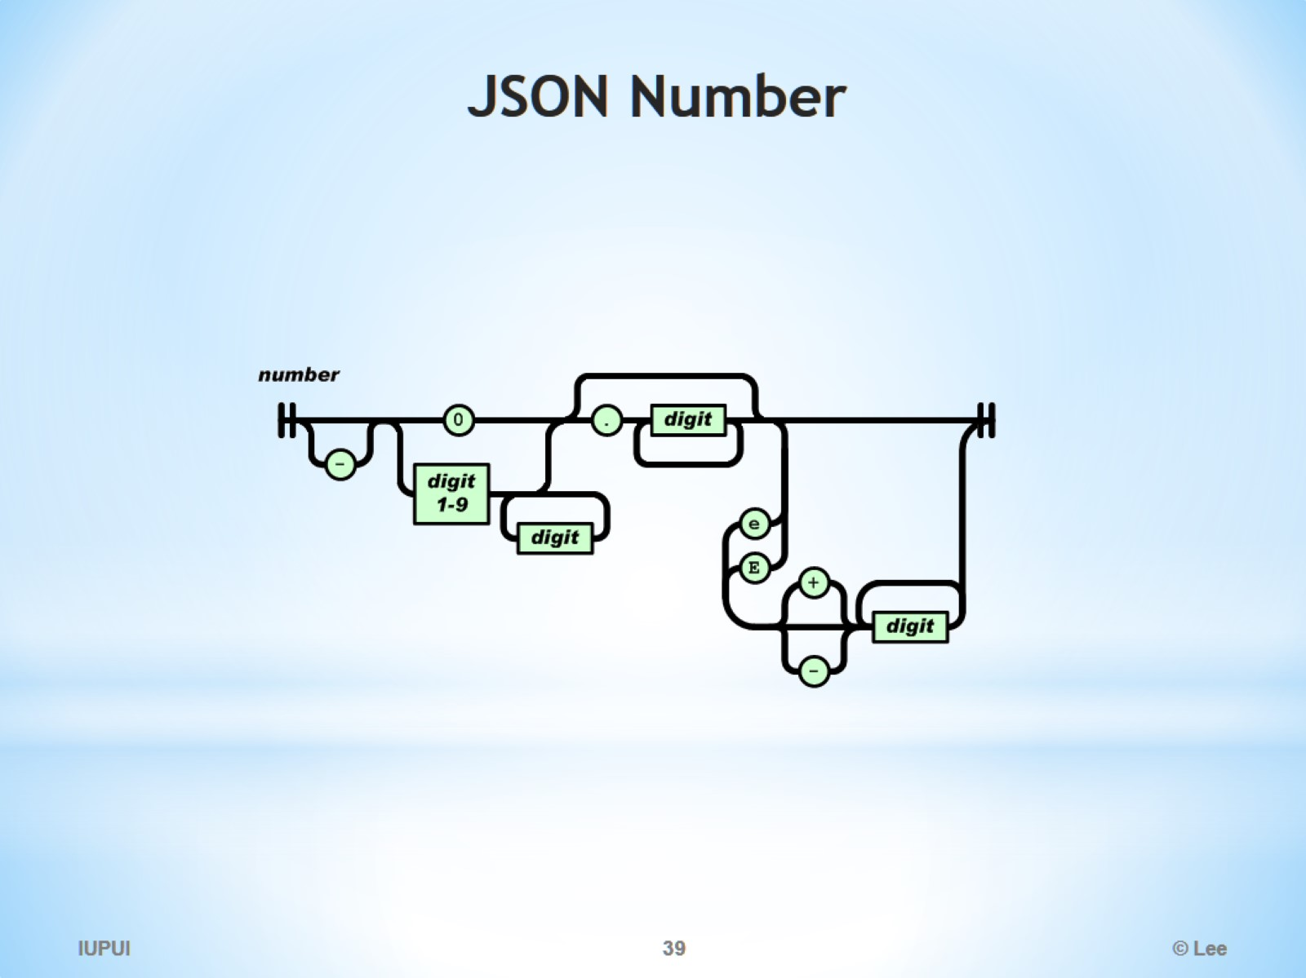
JSON Number

Slide 40
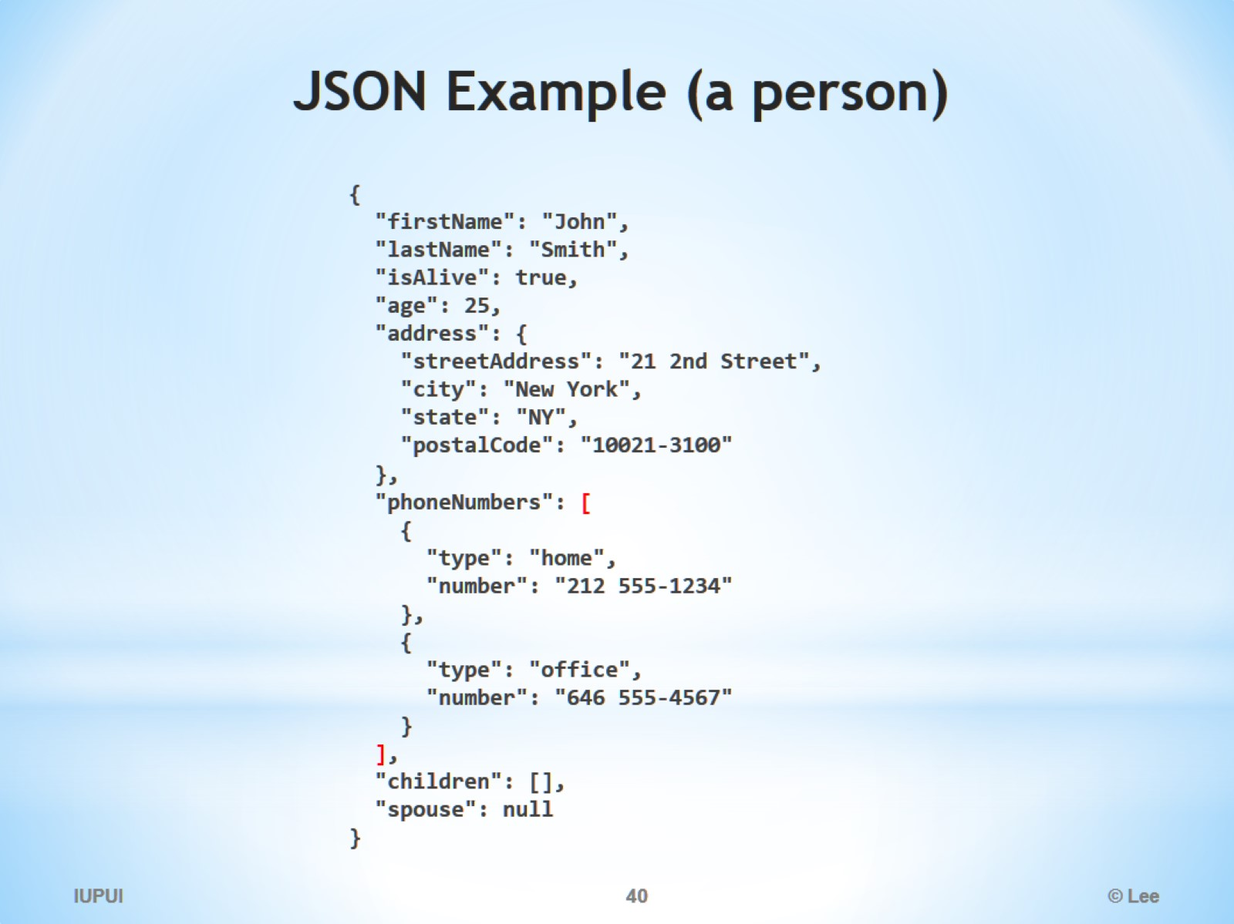
JSON Example (a person)

Slide 41
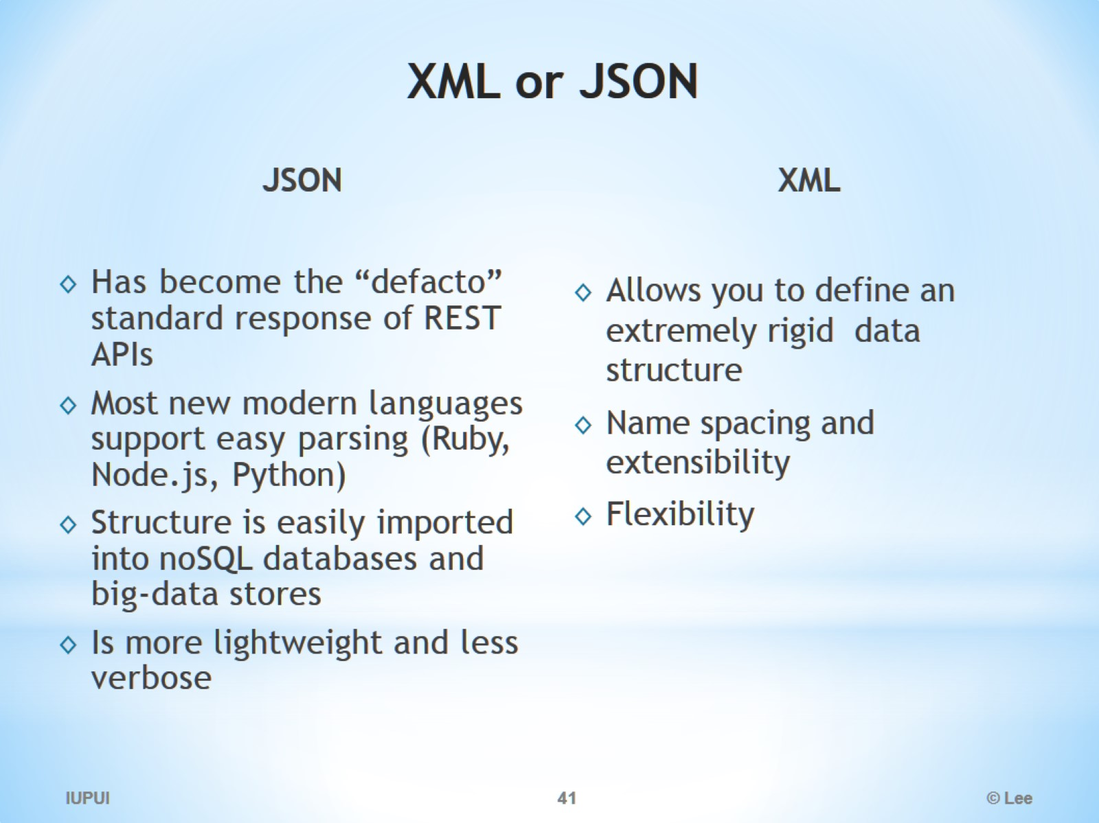
XML or JSON

Slide 42
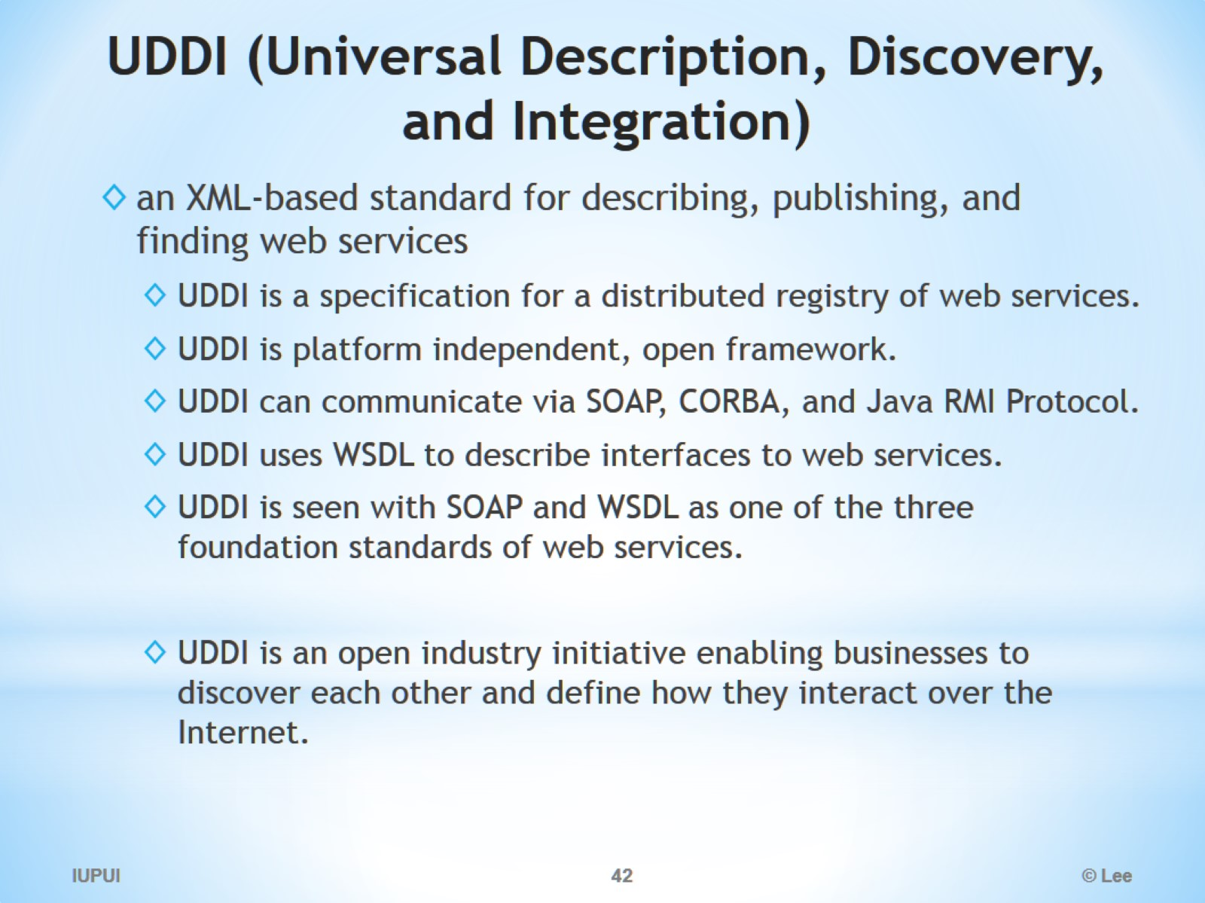
UDDI (Universal Description, Discovery, and Integration)

Slide 43
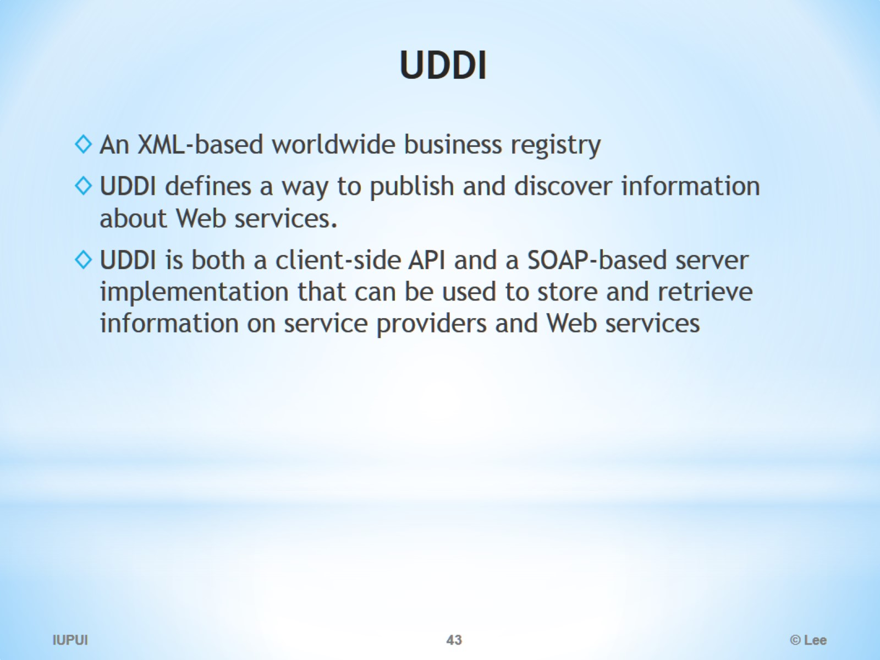
UDDI

Slide 44
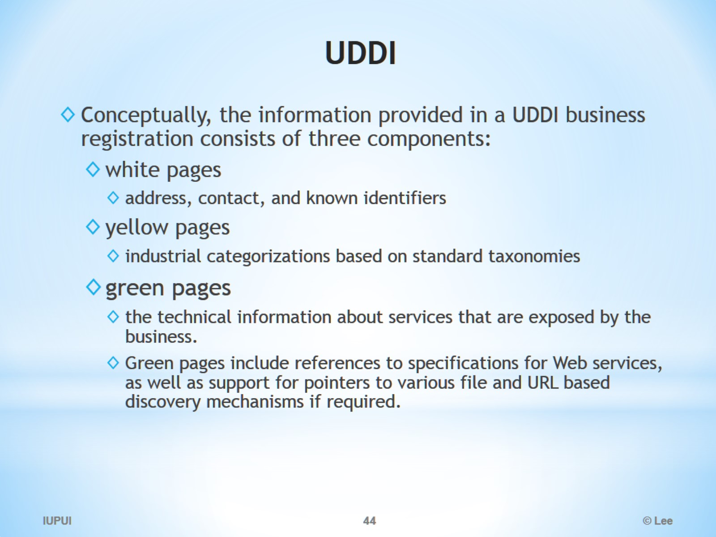
UDDI

Slide 45
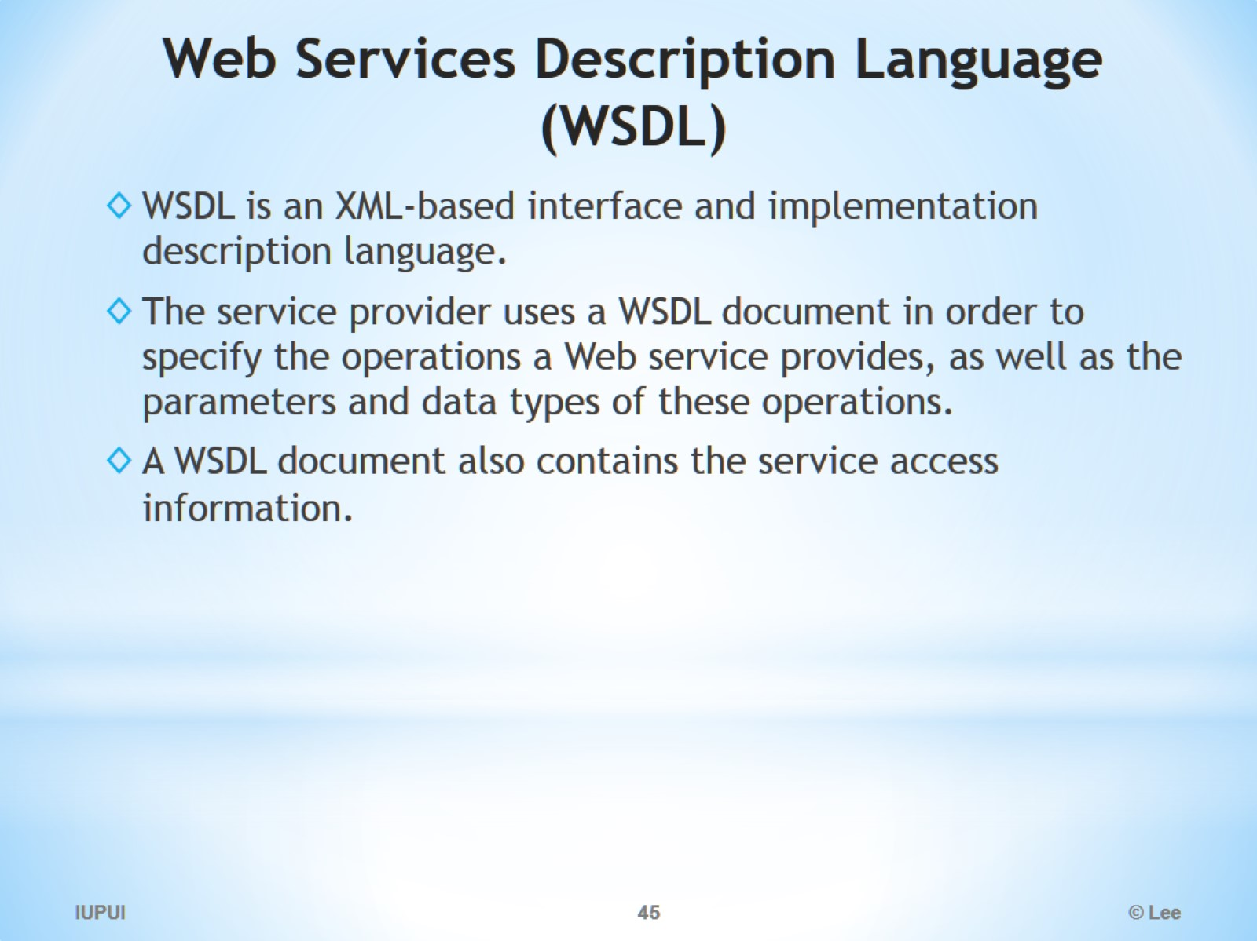
Web Services Description Language (WSDL)

Slide 46
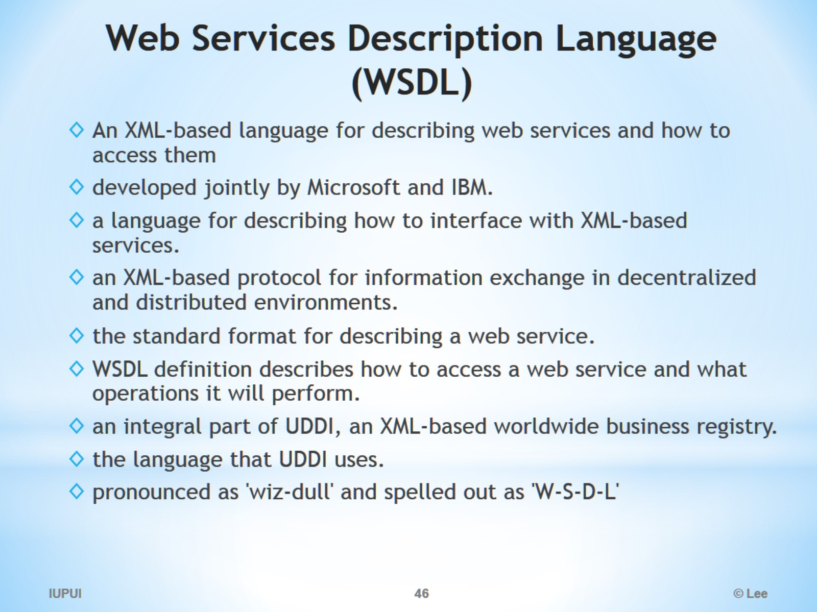
Web Services Description Language (WSDL)

Slide 47
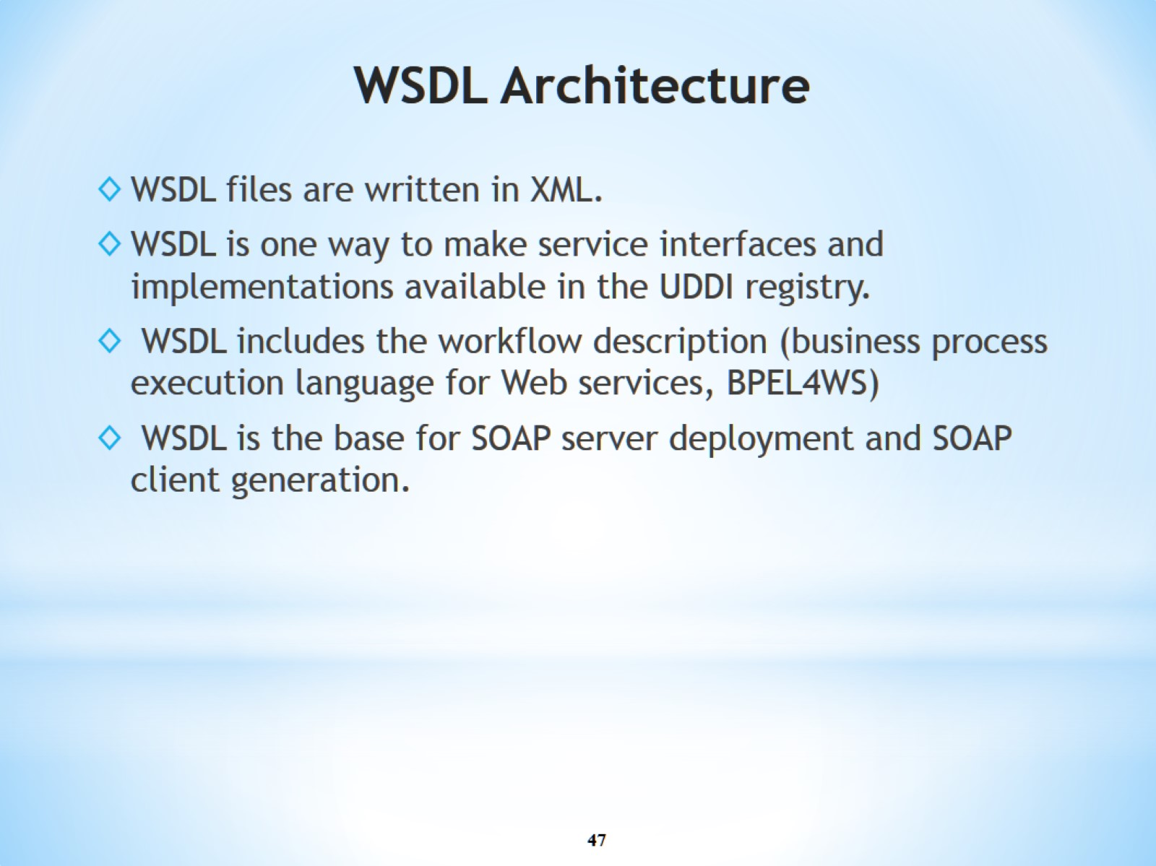
WSDL Architecture

Slide 48
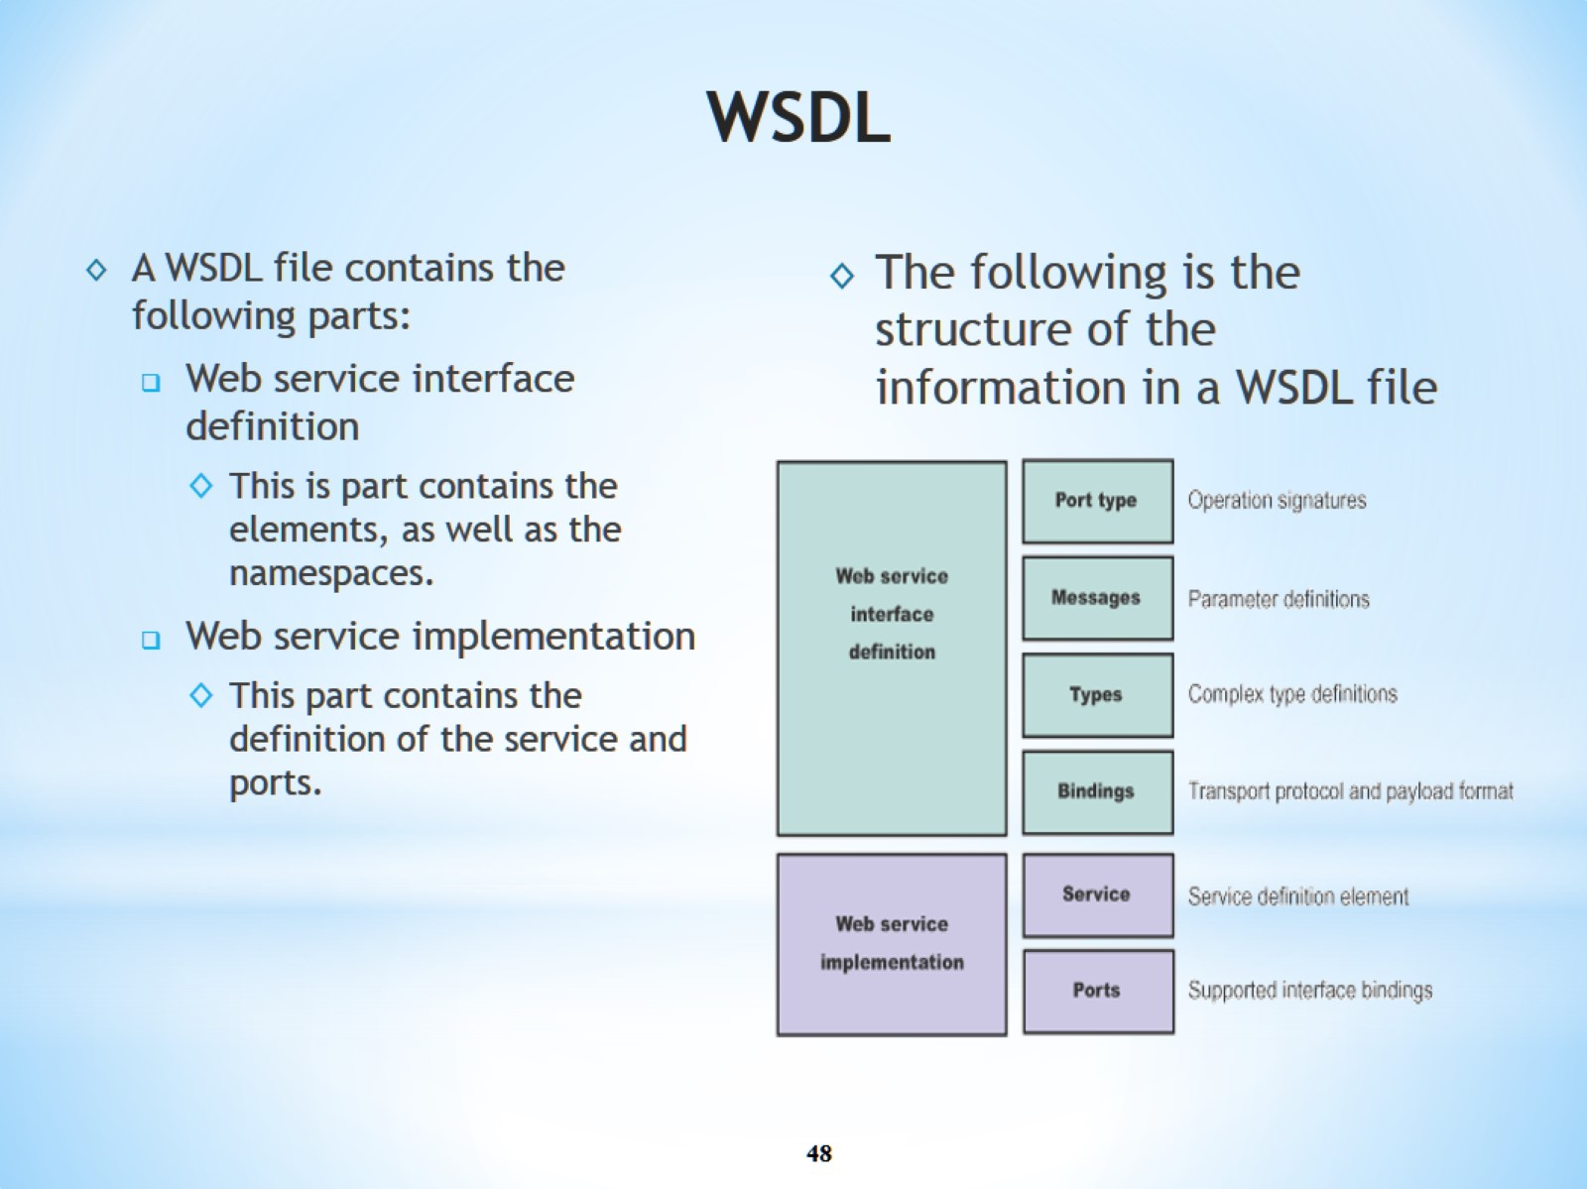
WSDL

Slide 49
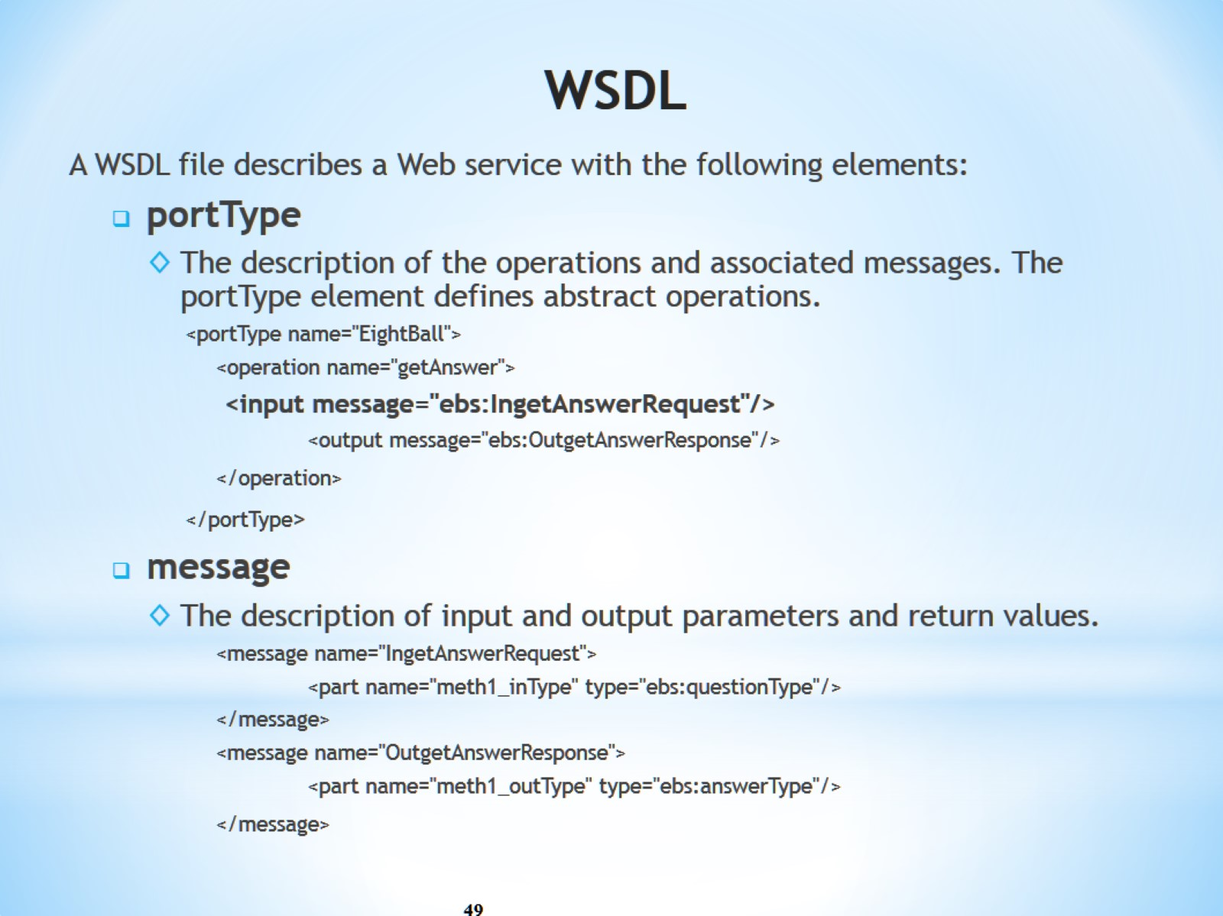
WSDL

Slide 50
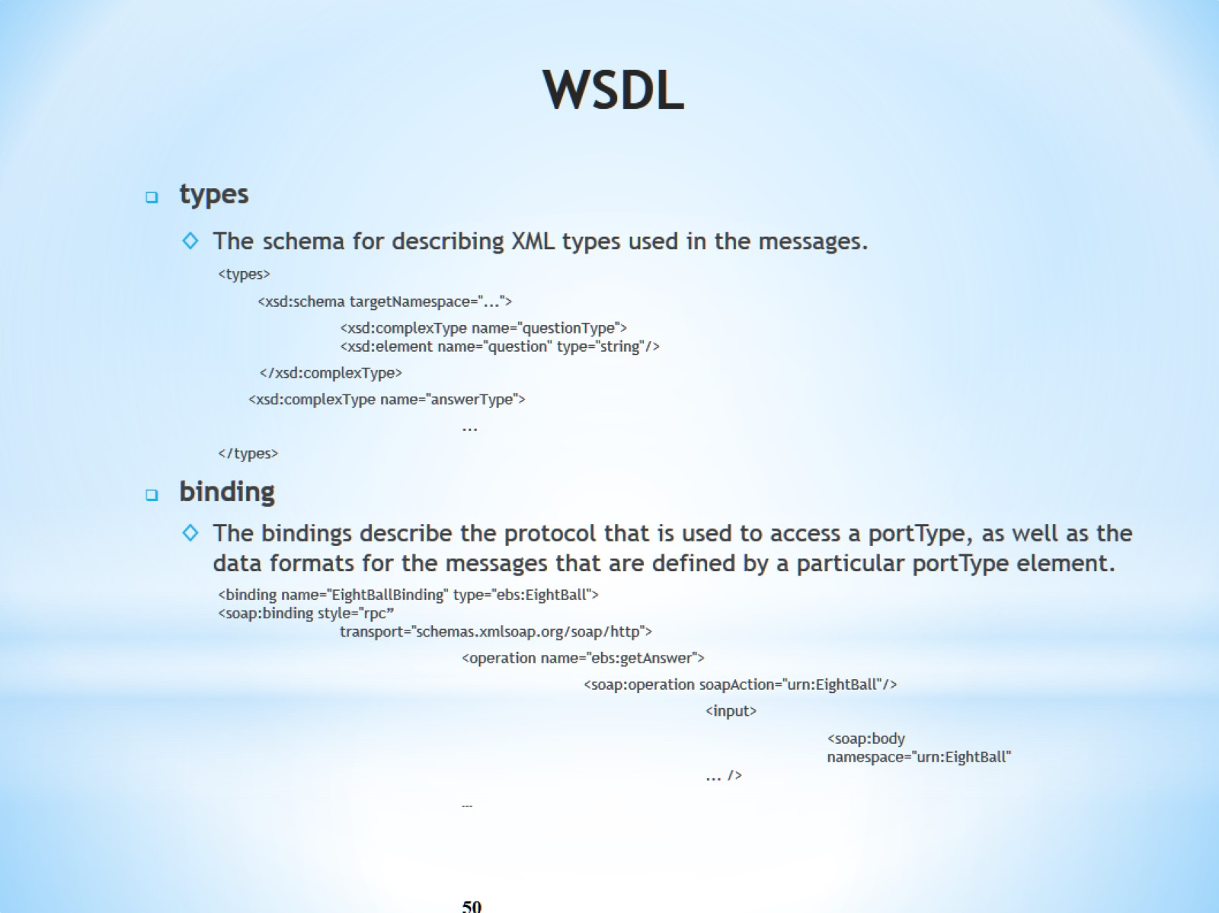
WSDL

Slide 51

WSDL

Slide 52

Web Service Architecture

Slide 53

Supports Remote Procedure Calls (RPCs)

Slide 54

Web Service Protocol Stack

Slide 55

Web Service Protocol Stack

Slide 56

Web Service Protocol Stack

Slide 57

Blocks Extensible Exchange Protocol (BEEP)

Slide 58

Who Uses Web Services

